Slide 1

Food Safety at farmers markets
Virginia Department of Agriculture & Consumer Services
Office of Dairy & Foods
Food Safety Program
April 2025
Notes:
INTRODUCE YOURSELF, Today I will be overviewing various permitting requirements and regulations that pertain to operating at a Farmers Market. Please hold questions till the end

Slide 2
Legislative Updates
2024 General Assembly Updates to the Virginia Food and Drink Law Exemptions:
  lis.virginia.gov > Bills & Resolutions > 2024 Session > HB759
  Food inspections; private homes; pickles and acidified vegetables; gross sales.
    Increases from $3,000 to $9,000 the gross sales annual revenue cap for sales of pickles and other acidified vegetables that have an equilibrium pH value of 4.6 or lower and are processed and prepared in a private home without an inspection as otherwise required to operate a food establishment
    Expands the exemption for private homes where the resident processes and prepares certain food products to allow for such person to sell the food at a temporary event that operates for a period of no more than 14 consecutive days
    Also clarifies that such person may advertise such food products over the Internet provided that the sale takes place in person and complies with certain restrictions
Notes:
Last year there were a few significant legislative updates, there was an increase for the gross annual sales of pickles and other acidified vegetable that went from $3,000 to $9,000. The updated legislation also expanded the exemption for private home operators to be able to sell their food at temporary events. It also updated to add that these exempt processors may advertise their foods over the internet. This year there have been no new legislative updates that impact the 2025 Farmers Market season.

Slide 3
Jurisdiction & Regulations
  Jurisdiction:
  VDACS
    Retail stores such as grocery and convenience stores
    Large and small manufacturers, including home kitchens and commercial kitchen food processing operations
    Warehouses
  VDH
    Restaurants
    Mobile food units
    Temporary food establishments
  Applicable Regulations:
Virginia Food and Drink Law
21 CFR 101 Food Labeling
21 CFR 117 Current Good Manufacturing Practices
Additional regulations for specific types of food (ex. seafood, juice, acidified foods, dietary supplements, etc.)
All food products must be made in an inspected kitchen, unless an exemption applies and is followed

Slide 4
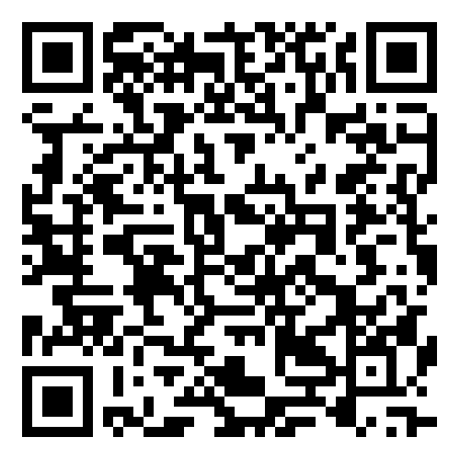
How to Start a New Food Processing Business in Virginia
VDACS Website
VDACS Food Safety Program
  Email: foodsafety@vdacs.virginia.gov
  Phone Number: 804-786-3520
Website Provides:
  Permit Applications for Home and Commercial Kitchen Food Processing operations
  “How To” documents for each application
  Informational handouts and guidance documents
  Links to laws and regulations
https://www.vdacs.virginia.gov/dairy-farmers-market-vendors.shtml

Slide 5
Home Kitchen Processor
Vs.
Commercial Kitchen Processor
Home Food Processor
Operates in a kitchen that is within a private residence.
Commercial Kitchen Processor
Operates in a shared/commissary kitchen that is not within a private residence.
Check your locality for any restrictions.
Must use a VDACS or VDH permitted food establishment.
Notes:
We also provide permitting for food Manufacturers, which operate in their own building that is provided with commercial-style equipment. This includes operations within a building that is on your own personal property but is not your home.

Slide 6
Permit Application Process
Submit your application packet to VDACS at foodsafety@vdacs.virginia.gov or by mail to PO Box 1163 Richmond, VA 23218-1163
An application reviewer may contact you for revisions or to request additional information prior to the approval of your application. Current reviews may take between 8-10 weeks.
After the application review is complete, a Food Safety Specialist will contact you to set up a preoperational inspection
Approval to sell your products is granted and a permit is issued following the satisfactory completion of the inspection
Ensure all items on the Application Checklist are provided with your Application Packet

Slide 7
New products
After you have completed the application process and initial inspection, you are approved to sell ONLY the products included in the approved application.
For new products, you must submit a new Product Information Sheet and Label to foodsafety@vdacs.virginia.gov for review and approval prior to offering the new products for sale.
NOTE: email a copy of your labels for review before having them printed

Slide 8

Pets in the Home
If you have pets within your home, then areas where food is prepared or stored must be completely enclosed/separated from the rest of the home.
Pets must be excluded from these areas at all times.
  For example, food processing and storage areas must be fitted with a solid hinged door that can be latched/closed shut.
  Placing pets in closed rooms in other areas of the home or installing "baby gates" will not satisfy this requirement.

Slide 9
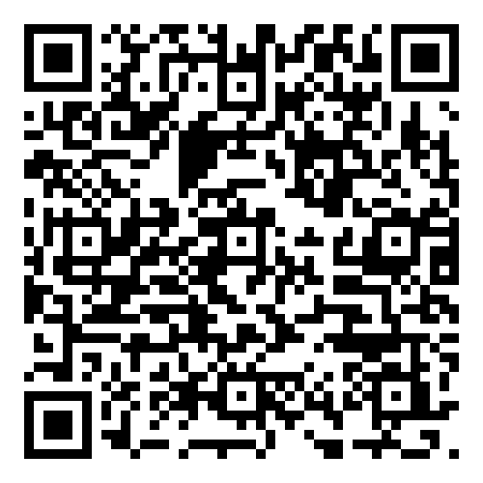
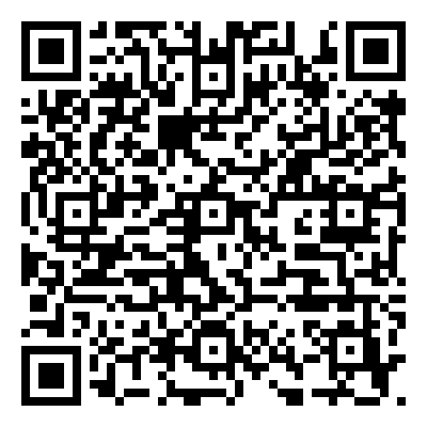
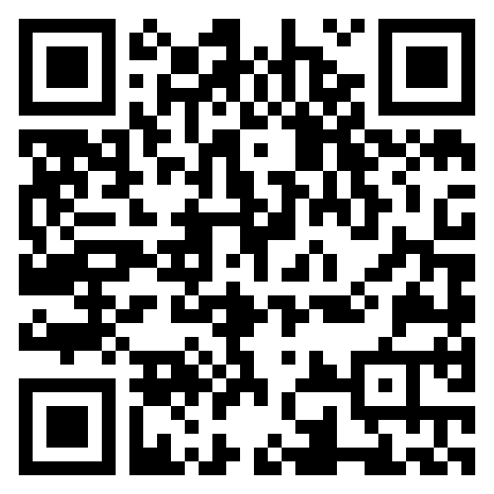
Specialized Processes
Juice HACCP
Juice:
Juice HACCP, 21 CFR 120
HACCP trained individual
Create and maintain a hazard analysis and HACCP plan
Seafood:
Seafood HACCP, 21 CFR 123
Seafood HACCP trained individual
Create and maintain HACCP plans
Dietary Supplements:
Dietary Supplements 21 CFR 111
https://www.fda.gov/food/hazard-analysis-critical-control-point-haccp/juice-haccp
Seafood HACCP
https://www.fda.gov/food/hazard-analysis-critical-control-point-haccp/seafood-haccp
Dietary Supplements
https://www.fda.gov/food/dietary-supplements
Notes:
These are specialized processes that require additional regulations and requirements. For more information please access the FDA websites pertaining to this information using the QR codes.

Slide 10
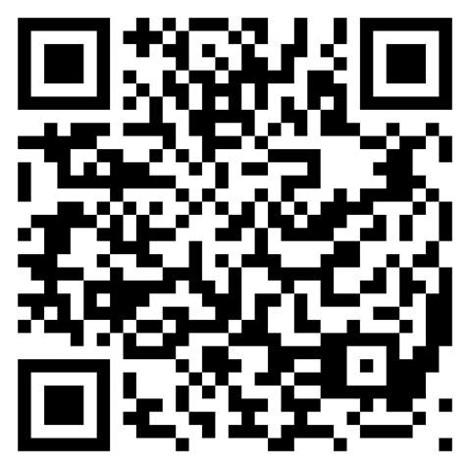
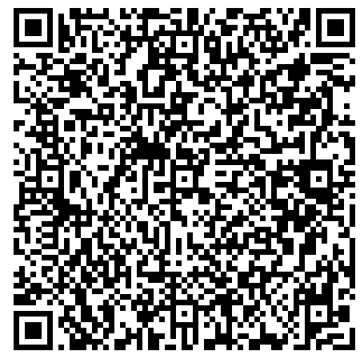
Acidified Food processing
AFDO Process Authority List
Acidified Foods:
Acidified Foods 21 CFR 114
Better Process Control School
Process Authority Evaluation
File with FDA
https://www.afdo.org/directories/fpa/
FDA Registration for Acidified Foods
https://www.fda.gov/food/registration-food-facilities-and-other-submissions/establishment-registration-process-filing-acidified-and-low-acid-canned-foods-lacf
Notes:
Acidified Foods are shelf-stable food that have a low acid content but have added a food with a high acid content to make the end product have a high acid content; Final product has a pH of 4.6 or less.

Slide 11
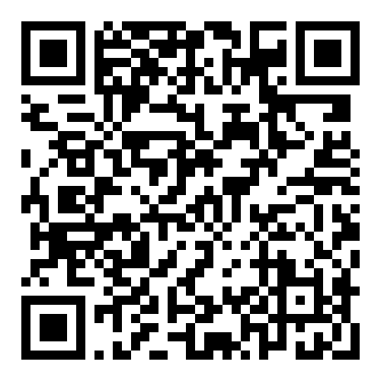
Dairy Processing
Manufacturing Dairy or Frozen Desserts:
Manufacturing dairy products like cheese or butter or frozen desserts like ice cream
Contact VDACS Dairy Services.
804-786-1452 or 804-371-7792
dairyservices@vdacs.virginia.gov
Manufacturing Grade A Dairy Products
Manufacturing products such as pasteurized milk, yogurt, cottage cheese, or sour cream
Contact the Virginia Department of Health.
VDH Local Health Districts
https://www.vdh.virginia.gov/local-health-districts/

Slide 12
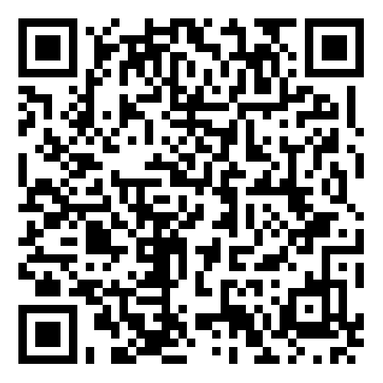
Meat & Poultry Products
Food containing meat, poultry, or catfish cannot be made in a home food processing operation.
Commercial kitchen processors may make certain meat or poultry products under the VDACS Office of Dairy and Foods. Examples include:
  Closed face sandwiches.
  Products containing less than 2% cooked meat/poultry or 3% raw meat/poultry.
  For other meat and poultry products, contact the VDACS Office of Meat & Poultry Services.
VDACS MEAT & POULTRY SERVICES
https://www.vdacs.virginia.gov/animals-meat-and-poultry.shtml

Slide 13
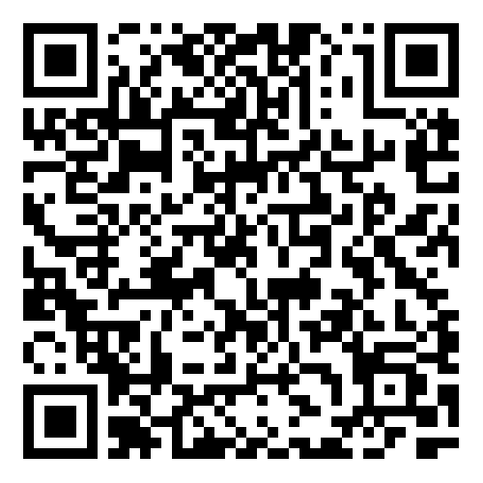
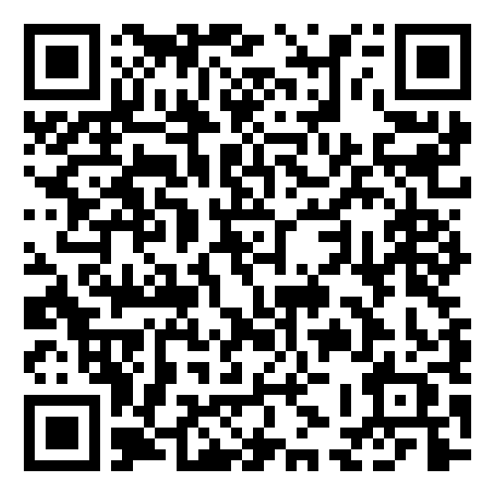
Alcohol in Food
Food products cannot be sold in VA if it has more than 0.5% Alcohol by Volume (ABV)
  Anyone that wants to sell a product with alcohol in it must have the product tested for alcohol content
  Test results showing it is below the limit must be submitted
Exception: Virginia ABC would regulate food that has an alcohol content of greater than 0.5% ABV as an alcoholic beverage/product
Contact Virginia ABC to discuss your specific situation.
Confectionary Permit
https://www.abc.virginia.gov/licenses/val/definitions/confectionary
Culinary Permit
https://www.abc.virginia.gov/licenses/val/definitions/culinary-permit

Slide 14
Eggs
You can sell the following without state inspection:
Up to 150 dozen eggs/week produced by your own hens
Up to 60 dozen eggs/week from another producer’s hens
Eggs offered for sale at farmers markets must be:
Clean and unbroken
Properly refrigerated at 45°F or below
Properly labeled

Slide 15
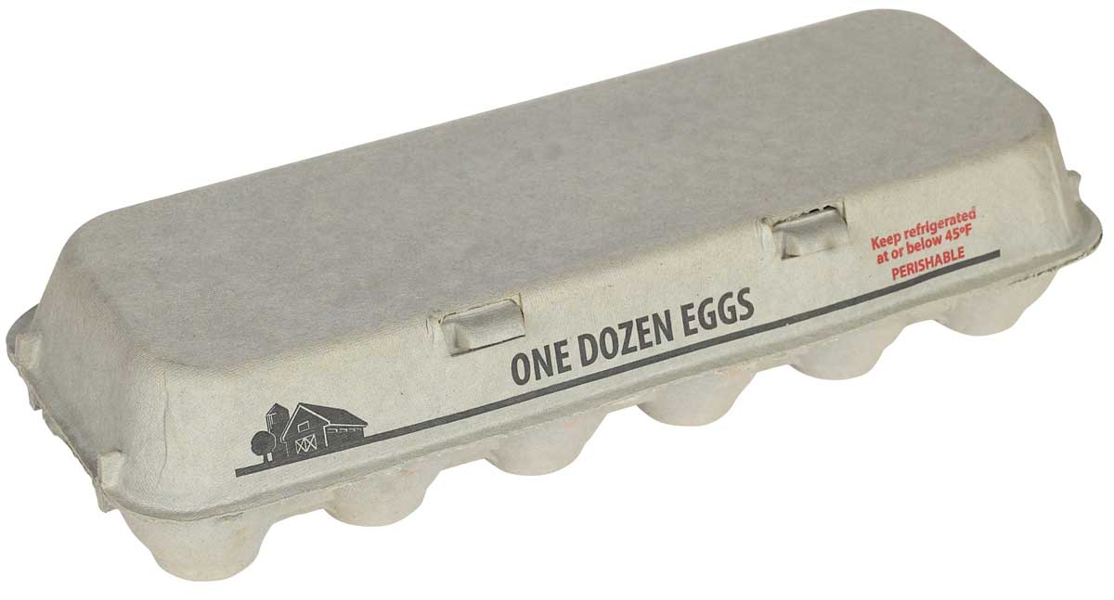
Egg Labeling
Labeling Requirements
Statement of Identity: EGGS
Net quantity: 12 eggs, 1 dozen
Business name and address
The appropriate grade or “ungraded” if none
Eggs labeled as “Fresh” must meet Grade A standards
Keep refrigerated statement and safe handling instructions

Slide 16
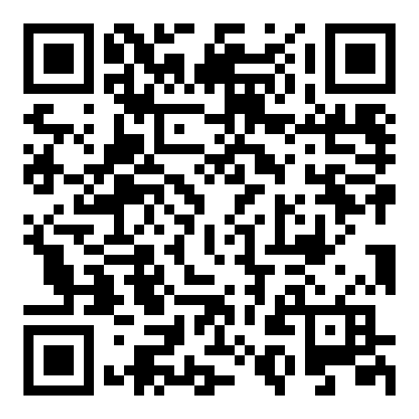
Home Kitchen food processing Exemption
VDACS Home Kitchen Food Processing Exemption FAQ’s
Section § 3.2-5130 of the Code of Virginia allows certain foods to be made from a private home without a permit from the VDACS Food Safety Program, with certain restrictions.
The foods allowed under the exemption include:
  Low Risk Foods
  Acidified Foods
  Honey
https://www.vdacs.virginia.gov/pdf/kitchenbillfaq.pdf

Slide 17
Low Risk Foods allowed Under Exemption
Candies
Jams and jellies not considered to be low-acid or acidified low-acid food products
Dried fruits
Dried herbs
Dry seasonings
Dry mixtures
Coated and uncoated nuts
Vinegars and flavored vinegars
Popcorn and popcorn balls
Cotton candy
Dried pasta
Dry baking mixes
Roasted coffee
Dried tea
Cereals
Trail mixes
Granola
Baked goods that do not require time or temperature control after preparation

Slide 18
Requirements for Low-Risk Foods produced under the exemption
Products can only be made in your own private home and sold in person to an individual for their own consumption.
Product packages are required to be labeled with information on the principal display panel as required by law.
The producer’s telephone number, the food’s production date, and the statement "NOT FOR RESALE — PROCESSED AND PREPARED WITHOUT STATE INSPECTION” must also be on the label.
Products can be sold from the private home where the product was manufactured, at a farmers’ market, or at a temporary event that operates for a period of no more than 14 consecutive days.
Products cannot be sold to other businesses for resale, on the internet, or across state lines.

Slide 19
Acidified Foods allowed Under Exemption
Pickles that have an equilibrium pH of 4.6 or lower.
Acidified vegetables that have an equilibrium pH of 4.6 or lower.

Slide 20
Acidified Food Precautions
To reduce the likelihood of foodborne illness, home-canned acidified food must have an equilibrium pH value of 4.6 or lower to inhibit the growth and formation of toxins from the bacteria that cause botulism.
  An electronic pH meter should be purchased so that you can test the product.
The home food processor is responsible for determining whether the product is an acidified food.
  We strongly advise that you have your manufacturing process reviewed and validated by a competent process authority.
  Home processors are strongly encouraged to complete a recognized Better Process Control School course.

Slide 21
Requirements for Acidified Foods produced under the exemption
Products can only be made in your own private home and sold in person to an individual for their own consumption.
Product packages are required to be labeled with information on the principal display panel as required by law.
The producer’s telephone number, the food’s production date, and the statement "NOT FOR RESALE — PROCESSED AND PREPARED WITHOUT STATE INSPECTION” must also be on the label.
Products can be sold from the private home where the product was manufactured, at a farmers’ market, or at a temporary event that operates for a period of no more than 14 consecutive days.
Products cannot be sold to other businesses for resale, on the internet, or across state lines.
Producers of acidified foods must not exceed $9,000 in total annual gross sales for all acidified products produced.
Products NOT permitted under the exemption include:
  Canned fermented foods
  Canned foods that require refrigeration for safety
  Canned acid foods
  Canned fruits
  Low-acid canned vegetables

Slide 22
Honey ALLOWED Under Exemption
What are the criteria for the exemption?
Private homes where the resident processes and prepares pure honey produced by his own hives.
The resident sells less than 250 gallons of honey annually.
The resident does not process and sell other food products in addition to the honey, except as allowed under exemption (low risk foods and acidified foods).
Where can the honey be processed?
In your own private home.
What types of home processed honey products are NOT allowed?
Infused honey products would not fall under the exemption as they are considered value-added honey products, not pure honey.
What are the labeling requirements for home‐processed honey?
The product is labeled “PROCESSED AND PREPARED WITHOUT STATE INSPECTION. WARNING: Do Not Feed Honey to Infants Under One Year Old.”
In addition, this exemption does not preclude the need for standard labeling information on the product label (name of product, net weight statement, name and address of the manufacturer, etc.)
Where can I sell my honey and to whom can I sell it?
Currently there are no restrictions regarding where the honey can be sold and who it may be sold to.

Slide 23
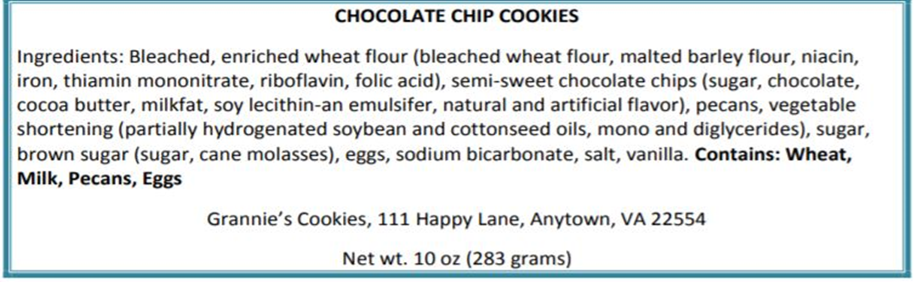
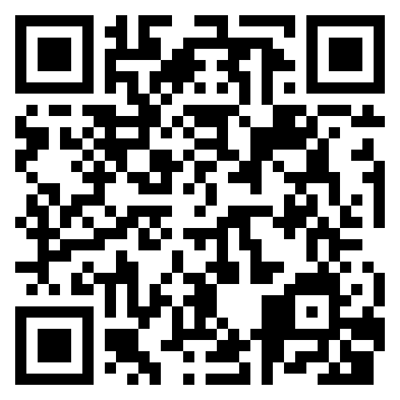
Labeling
Statement of identity (common name of product)
Ingredients list, including sub-ingredients and allergens, listed in order from most heavy to least heavy
Name and address of manufacturer, packer, or distributor
Net quantity statement in standard and metric units
https://www.fda.gov/media/81606/download
Notes:
Call back to exemption labeling – mandatory labeling PLUS disclaimer statement

Slide 24
Allergen labeling
When an ALLERGEN is included in an ingredient, the common key allergen word must be included on the label in the ingredient statement or in an allergen “contains statement”.
The key allergen words for the nine common allergens are: Milk, Wheat, Eggs, Peanuts, Tree Nuts (name the specific type of nut), Soybeans, Fish (name the specific type of fish), Crustacean Shellfish, and Sesame.

Slide 25
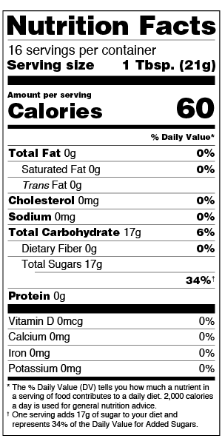
Nutritional Labeling
Section 403(q) of the Federal Food, Drug and Cosmetic Act requires that packaged foods and dietary supplements bear nutrition labeling unless they qualify for an exemption.
The exemption is based on the number of employees and number of product units sold.
The exemption applies to businesses with fewer than 100 employees and products fewer than 100,000 units.
  The number of employees is based on the average number of full-time equivalent employees.
  No exemption may be taken if a company has more than the number of employees listed regardless of number of units produced.
If a company has less than 10 employees and products less than 10,000 units sold, there is no need to file for an exemption.

Slide 26

Preparing for the Market

Slide 27
Heading to The Market
Make sure you purchased your food from an Approved Source
Keep your time/temperature control for safety (TCS) foods at or below 41°F when transporting.
You can use a cooler with ice or a refrigerated truck.
Use a thermometer to ensure the cooler or truck is at 41°F or below
Keep your transportation vehicle clean

Slide 28
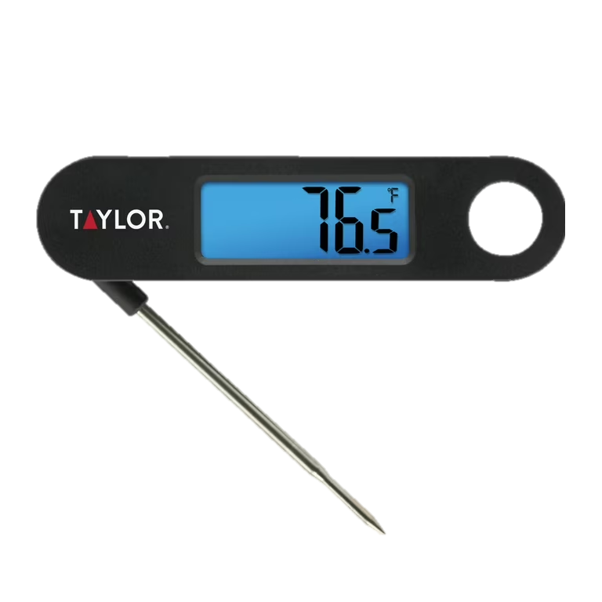
Temperature Control for TCS Foods
Cold Holding: 41°F or below
Hot Holding: 135°F or above
Use a probe type thermometer to check internal temperatures of time/temperature control for safety (TCS) foods
Keep display thermometers in coolers
Ice or electrical/gas powered equipment may be used provided acceptable temperatures are achieved

Slide 29
Using ice for food storage
Ice and ice packs may be used for temperature control of cold items provided acceptable temperatures are achieved (41°F or below)
Ice must be drained frequently
Except for fruits and vegetables, do not store foods in direct contact with ice
Recommendations:
  Bring an extra cooler full of just ice and/or extra ice packs
  Provide pictures or a menu so your customers know what you’re offering for sale without having to constantly open the cooler
  Food items that are held outside of the cooler “for display only” must be discarded at the end of the day

Slide 30
Protecting your food at the Market
Store food and equipment in a clean and dry location where it is not exposed to splash, dust, or other contaminants.
No barehand contact with food.
Protect food from customers.
  Cover food or use sneeze guards.
Keep equipment clean.
Have overhead cover and ground cover.

Slide 31
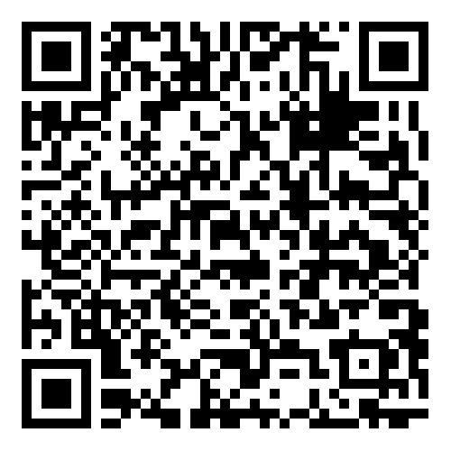
Best practices for sampling at the market
Guidelines for Providing Safe Food Samples at the Market
Try to prep before getting to the market
Set up a handwashing station
  Water dispenser, catch basin, soap, and paper towels
Use tongs, deli paper, toothpicks, etc. to provide the sample to the customer
Use clean utensils and equipment
  Recommend bringing extra equipment or set up warewashing station (wash, rinse, sanitize)
TCS foods should either be kept cold (41°F or below) or discarded after 4 hours
Keep food covered to prevent contamination from pests
Make sure customers and employees are aware of allergens in the samples
https://www.vdacs.virginia.gov/pdf/farmers-mkt-safe-food-samples.pdf

Slide 32
Practice Good Personal Hygiene & Cleanliness
No discharge from eyes, nose, or mouth
Clean outer garments
Hair restraints
No smoking, eating, or drinking
Washing hands
No fingernail polish
No jewelry on hands or arms

Slide 33
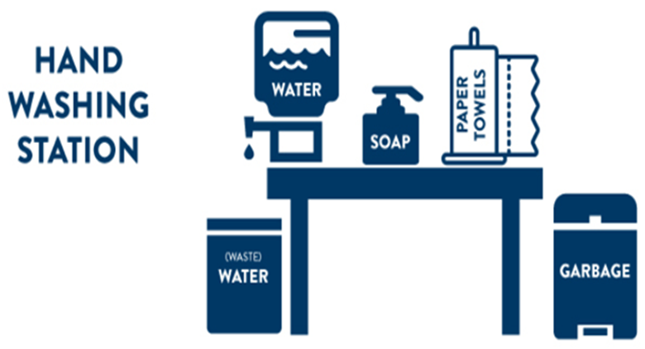
Handwashing at the Market

Slide 34
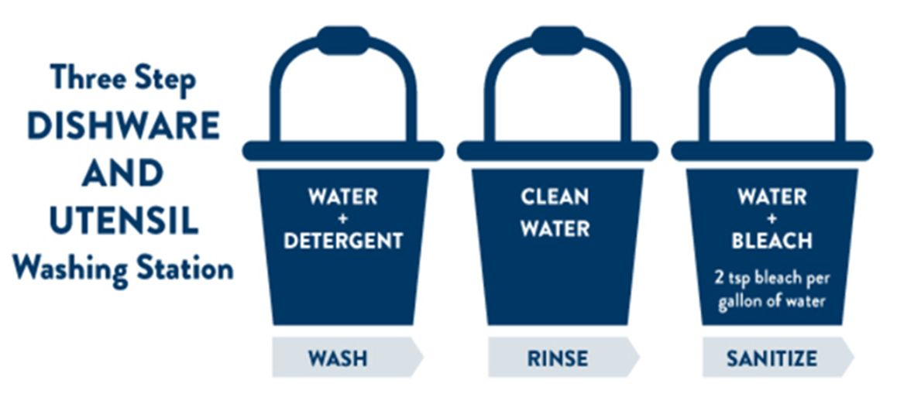
Ware washing at the Market

Slide 35
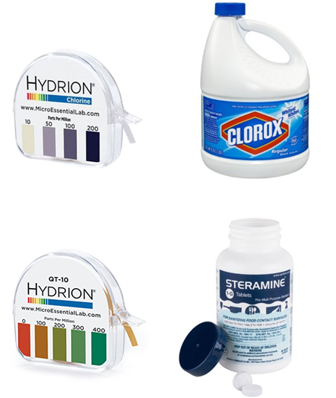
Sanitizing Equipment
Sanitizers used must be approved for sanitizing food-contact surfaces and used in accordance with the manufacturer instructions
Test strips are used to measure and ensure you have the appropriate concentration of sanitizer
  50-100 ppm chlorine bleach
  200-400 ppm quaternary ammonium

Slide 36
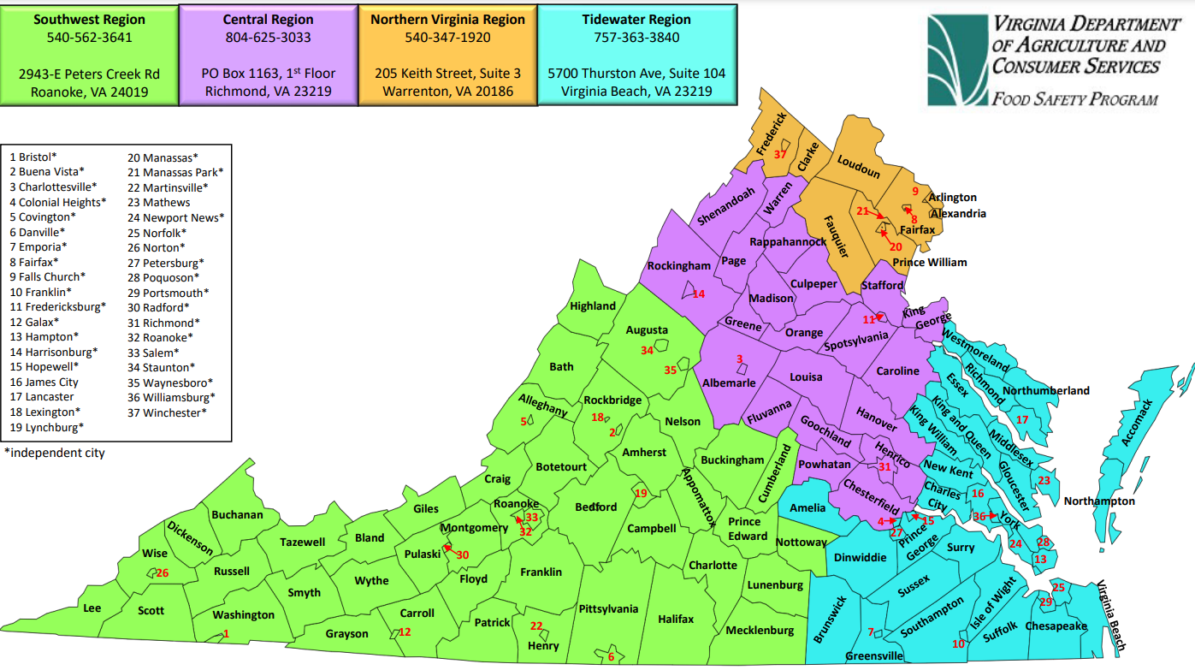
Food safety program regional map
https://www.vdacs.virginia.gov/pdf/Regional-Contact-Map.pdf

Slide 37
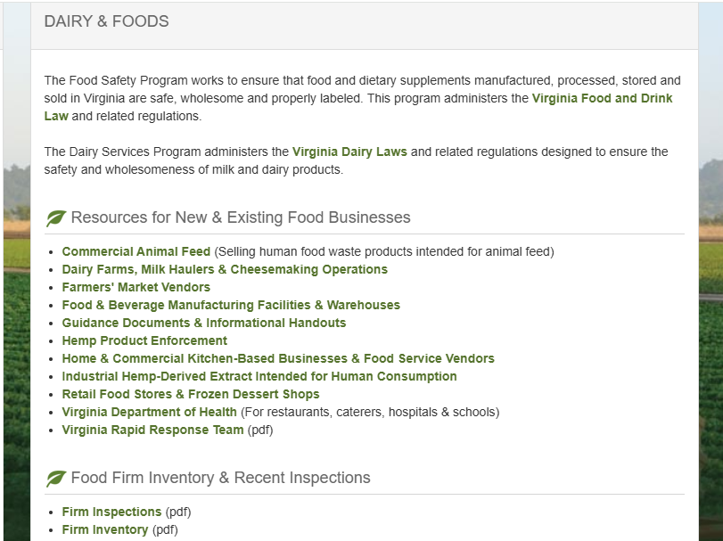
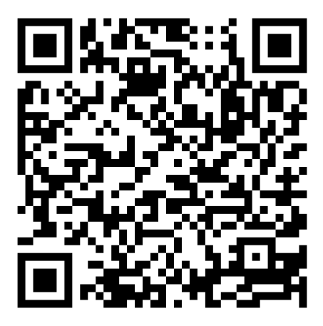
Food Safety Program firm inventory
Website Provides:
  Inventory of permitted firms
  Information on recent inspections
https://www.vdacs.virginia.gov/food-dairy-and-foods.shtml

Slide 38
Questions?
VDACS Food Safety Program
  foodsafety@vdacs.virginia.gov
  804-786-3520
Karen Bergin, Food Safety Manager
  Karen.Bergin@vdacs.virginia.gov
Rashelly Bland, Food Safety Manager
  Rashelly.Bland@vdacs.virginia.gov

