Slide 1

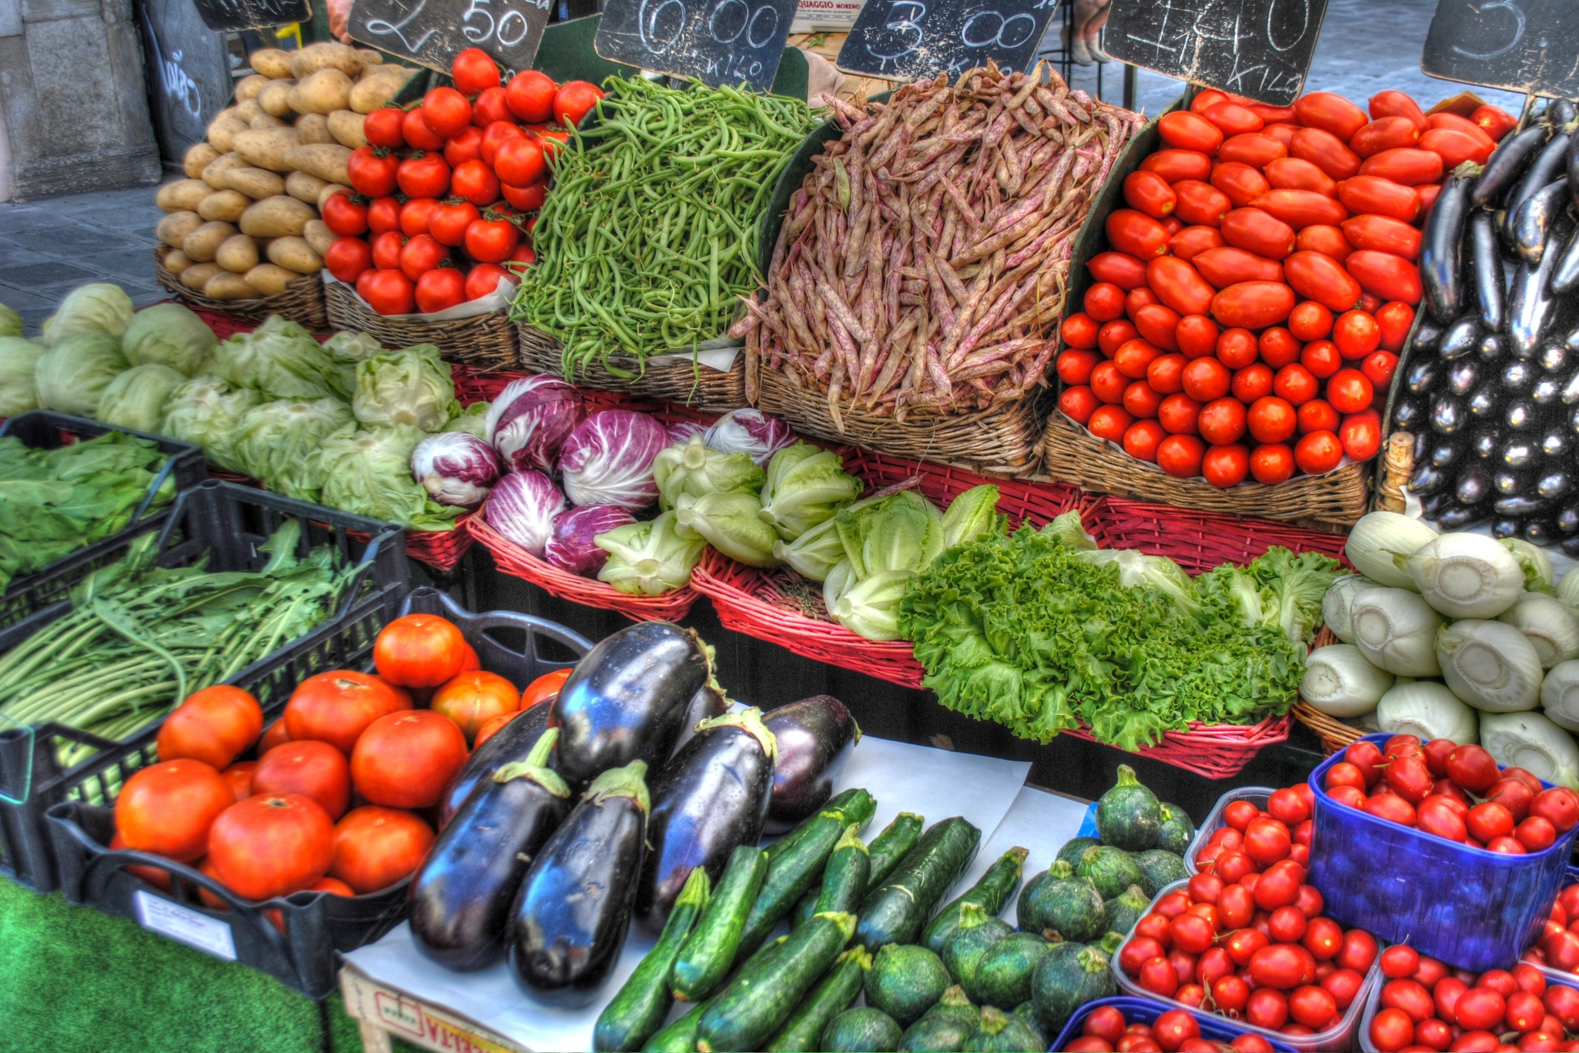
VDH Farmers Market Permitting & Food Safety 101
Virginia Department of Health, Division of Food and General Environmental Services
Whitney Wright,
Environmental Health Coordinator
Whitney.Wright@vdh.virginia.gov
Jessica Klemencic,
Food Safety Quality Assurance Coordinator
Jessica.Klemencic@vdh.virginia.gov
Notes:
Speaker: Whitney Wright
Good morning, and welcome to everyone. It is a pleasure to be with you all this morning.
Today we will be providing an overview of Virginia Department of Health Permitting and Food Safety 101 at Virginia Farmers Markets.
My name is Whitney Wright, and I am an Environmental Health Coordinator in the Office of Environmental Health Services Food Safety Division.
Presenting with me this morning is Jessica Klemencic who is our Food Safety Quality Assurance Coordinator.
Please feel free to put questions in the Q&A during the presentation and we will have time at the end to cover as many as we can. Also, as always you can send us questions directly through the VDH FoodSafety Inbox.

Slide 2
Acronyms Used Throughout the Presentation:
CFPM = Certified Food Protection Manager
FDA = Food and Drug Administration
LHD = Local Health District (35 total in Virginia)
MOU = Memorandum of Understanding
PIC = Person-in-Charge
TCS Food = Time-Temperature Control for Safety Food
TFE = Temporary Food Establishment
VDACS = Virginia Department of Agriculture and Consumer Services
VDH = Virginia Department of Health
Notes:
Speaker: Whitney Wright
In the Health Departments Food Safety Division, we have a way of speaking our own language and use several acronyms when discussing food safety.
So, this slide provides a few of the more commonly used acronyms.

Slide 3
New Food Safety Laws from the 2024 General Assembly
Food Safety Exempt Organizations:
Churches
Fraternal or School Organizations
501 (c) (3) Exempt Organizations
Vol. Fire and Medical Services
For the above organizations, the following requirements apply:
Event must be no more than 2 days
Food may only be prepared in the following locations:
Homes of members
Kitchen of Church, School, or Organization
Purchased or donated from a permitted food establishment.
Food prepared onsite at an event is not exempt from a permit, however the fee for the permit would be waived.
Notes:
Speaker: Whitney Wright
The next two slides are new for this season. At last years 2024 General Assembly Session there were 2 bills that passed and went into law on July 1st 2024.
On this slide is House Bill 57 that allowed Food Safety Exempt Organizations to now PARTICIPATE in other Events.
There are still 3 important limitations Exempt Organizations need to keep in mind:
Duration of event can not be more than 2 days
Food may only be prepared in the homes of its members, in the exempt organization's kitchen (if they have one), or purchased or donated from a permitted food establishment.
Lastly, Any food prepared onsite (such as at Farmers Market) is not exempt from a permit, however the permit fee for the exempt organization would be waived.

Slide 4
New Food Safety Laws from the 2024 General Assembly
Cottage Food and Acidified Vegetable Exemptions:
Acidified vegetables and cottage law foods may now be sold from any event where VDH would otherwise allow the operation of a temporary food establishment in addition to the vendor’s home.
Key Limitations:
Event must be 14 days or less.
All transactions must be in-person.
Only low risk foods that do not require time or temperature control for safety after preparation.
Gross sales of acidified vegetables may not exceed $9,000/yr.
Products may be advertised but not ordered or purchased over the internet (in-person use of cashless payments is allowed)
Notes:
Speaker: Whitney Wright
The second new bill was House Bill 759 (also known as the Cake pop Bill) that increased the gross sales annual revenue cap for sales of pickles and other acidified vegetables, and expanded the location of where acidified vegetables and cottage law foods can be sold at, including where they can advertise their products.
This new law is regulated by VDACS, and will be covered in more detail in their presentation following this one.
The key takeaway here is that these foods now can be sold from any event where VDH would otherwise allow the operation of a TFE which would include a Farmers Market!

Slide 5
What’s the Difference Between a VDH Vendor and a Farm Vendor?
VDH Vendor
Requires a VDH food establishment permit
Food service establishment preparing food for sale e.g., concessions direct to consumer
Examples are permitted food establishment, mobile unit, or TFE vendor
Food preparation occurs in VDH food establishment, mobile unit, or onsite at the market
Farm Vendor
Farmers selling their-own farm produced products direct to consumer at their farm or farmers' market
Includes farmers, growers, producers
Firms permitted by VDACS
Firms exempt by VDACS under VA “cottage law”
May provide a sample of product w/o VDH permit
Notes:
Speaker: Whitney Wright
We are often asked how can you tell the difference between a VDH Vendor and a Farm or Non-VDH Vendor at a Farmers Market?
One way to tell is by looking or asking to see their paper permit or sticker permit. VDH vendors that are set up in tents or other temporary set ups should have a paper permit posted from VDH, Mobile Units such as food trucks that are permitted through VDH will have a sticker that is affixed to the unit in a location visible to consumers. So, seeing is believing.
You can also look at what they are serving to help determine if it’s a VDH Vendor – VDH vendors will be preparing food on-site for sale or sample directly to consumers
As you will see on the right side of the slide Farm Vendors or Non-VDH vendors are either permitted or inspected by VDACS (or may be exempt by law); or are farmers selling their own farm produced products or offering samples of their farm produced products.

Slide 6
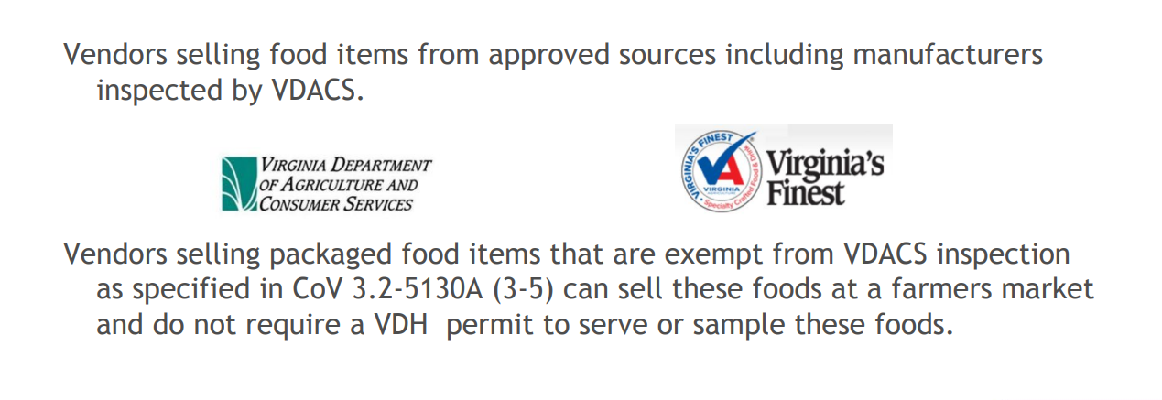
Vendors Not Inspected by VDH at the Farmers Market
Notes:
Speaker: Whitney Wright
There is a Memorandum of Understanding (MOU) between VDH and VDACS.
Under this MOU, many food vendors at farmers markets may be exempt from permitting and inspection by VDH.
Vendors who are not regulated by VDH include vendors selling food items from approved sources such as firms inspected by VDACS that include home and commercial kitchens and food and beverage manufacturers.
We also do not regulate vendors selling packaged food items that are exempt from VDACS inspection under the code section shown here. These vendors can sell their exempt products at farmers markets and do not require a VDH permit to sample these foods. VDACS will be sharing more details on this a little later this morning.

Slide 7

Products Exempt from VDH Inspection under CoV §35.1-14
“Farmers offering their own farm-produced products directly to consumers for their personal use,…”
At the farmers market, these farmers may offer samples of their farm-produced products, e.g.,:
sliced fruits and vegetables
cooked fruits and vegetables
cooked and prepared meat, poultry, seafood, eggs
Notes:
Speaker: Whitney Wright
Section 35.1-14 Regulations Governing Restaurants, advisory standards for exempt entities in the Code of Virginia states that…
The Provision of the Food and Drug administration’s Food Code shall not apply to farmers offering their own Farm-Produced products directly to consumers for their personal use, whether such sales occur on such farmer’s farm or at a farmers' market,…..
In addition to this exemption, Under the Memorandum of Understanding between VDH and VDACS mentioned earlier, sampling of these farm produced products are not subject to VDH permit or inspection.

Slide 8
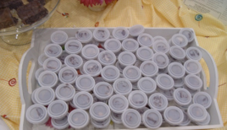


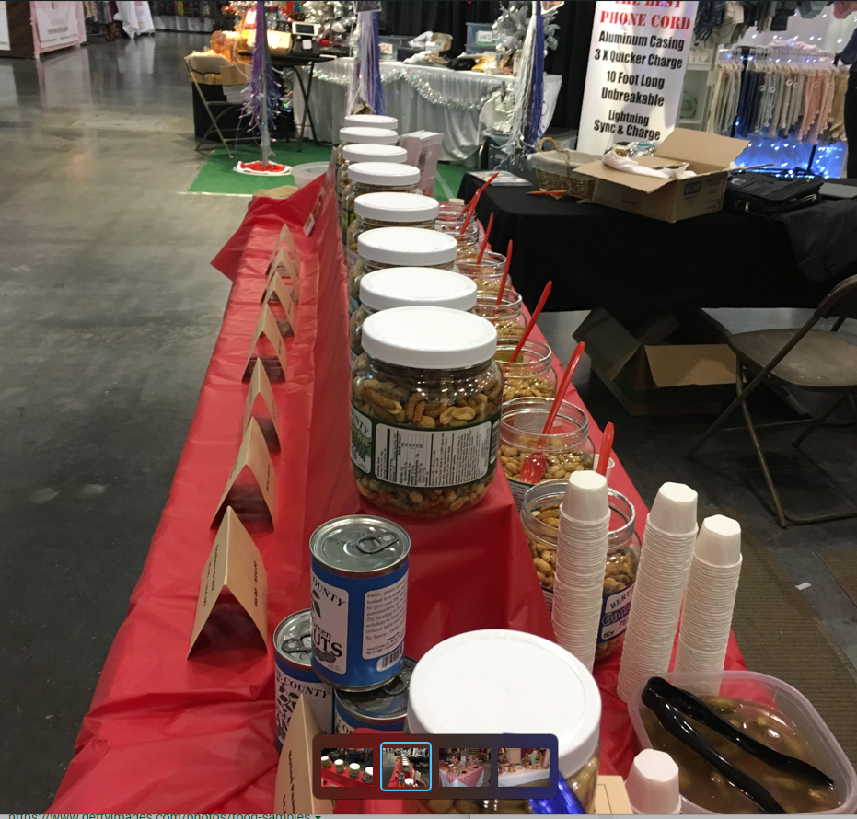
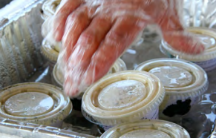
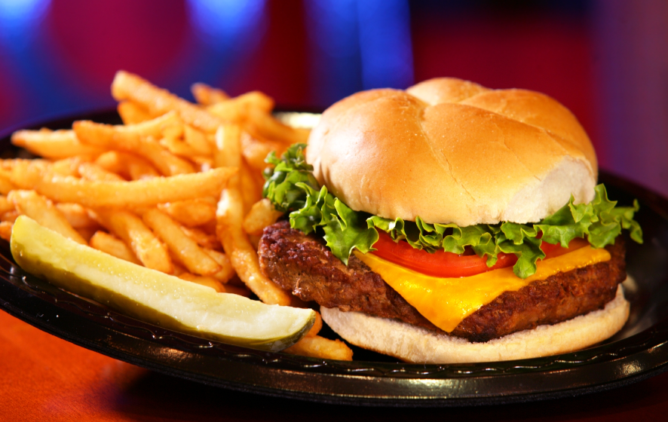


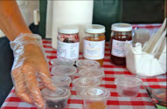
Food Service v. Sampling at a Farmers’ Market
Food Service
Sold to the consumer
Can be a meal or single entrée such as sandwich or slice of pizza
Food is prepared at a permitted food establishment (includes onsite as a TFE vendor)
Samples
Free
Bite-size portion
Showcases a food produced by farmer, producer, grower
Prepared in a VDACS approved kitchen or onsite
Notes:
Speaker: Whitney Wright
So how do you tell the difference between a Sample and Food Service?
Examples of permissible sampling under the MOU (not regulated by VDH) are: ● Cutting up produce for raw consumption ● Cutting up baked goods for consumption ● Heating/cooking a farm-produced sausage or other meat product with limited modification (seasoning acceptable, but not made into a dish) ● Mixing of dips and service with chips or pretzels ● Providing salsa, etc. for sampling with chips or pretzels
Examples of activities or samples that require a VDH permit are: ● Assembling a pizza, stir-fry, casserole, or salad
● Adding a piece of commercially-prepared hot dog to their baked good
In our next presentation VDACS will provide more details on guidelines for providing safe samples at farmers markets.

Slide 9

Vendors Inspected by VDH at the Farmers’ Market
Permitted Food Establishments
Mobile Units
Temporary Food Establishments
Notes:
Speaker: Whitney Wright
At Farmers Markets across Virginia, you will typically find 3 types of VDH permitted vendors.
Permitted Food Establishments – This is an annually permitted Food Establishment that is setting up as a vendor at a Farmers Market
Mobile Food Units – These are also annually permitted Food Establishments that are mobile (i.e. On wheels)
And the most common vendor at Farmers Markets are the Temporary Food Establishments – These are temporary vendors that are only permitted in connection to a temporary event such as a farmers' market.

Slide 10
Permitted Food Establishments:
Prepares and serves the same types of food at the market that is prepared and served at the permitted location e.g., restaurant setting up a booth at the farmers’ market
A copy of the permit must be posted
Inspected by VDH based on risk category
Notes:
Speaker: Whitney Wright
VDH Permitted Food Establishments sometimes choose to offer food from their normal brick and mortar operations and set up as a temporary vendor at an event such as a farmers' market.
When they choose to do so, they are allowed to prepare and serve the same types of food using the same process at the market that is done at their primary location and do not need to obtain additional permits.
A copy of their permit still must be posted, and they are subject to VDH inspection, and inspections are based on a VDH risk assessment risk category assigned to that establishment.

Slide 11
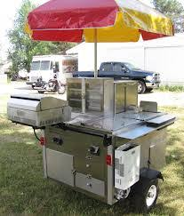

Mobile food unit:
Food establishment on wheels or readily movable at all times also known as “food truck” or “hot dog cart”
Permit issued by the LHD where the commissary is located or in the locality in which the operator resides, if a commissary is not required.
Annual permit that is valid statewide.
Notes:
Speaker: Whitney Wright
A Mobile Food Unit is defined as a food establishment mounted on wheels (excluding boats in the water) readily moveable from place to place at all times during operation and shall include pushcarts, trailers, trucks, or vans.
The Unit, all operations, and all equipment must be integral to and be within or attached to the unit.
These are commonly called Food Trucks or carts and are permitted by the Local Health Department where the commissary or owner/operator resides if a commissary is not required.
Due to the nature of the unit being mobile these food establishments have an annual permit sticker that is valid statewide, however some jurisdictions in the state may have additional permitting or requirements so please check ahead of setup and operation.

Slide 12
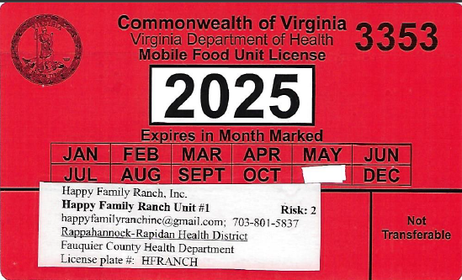
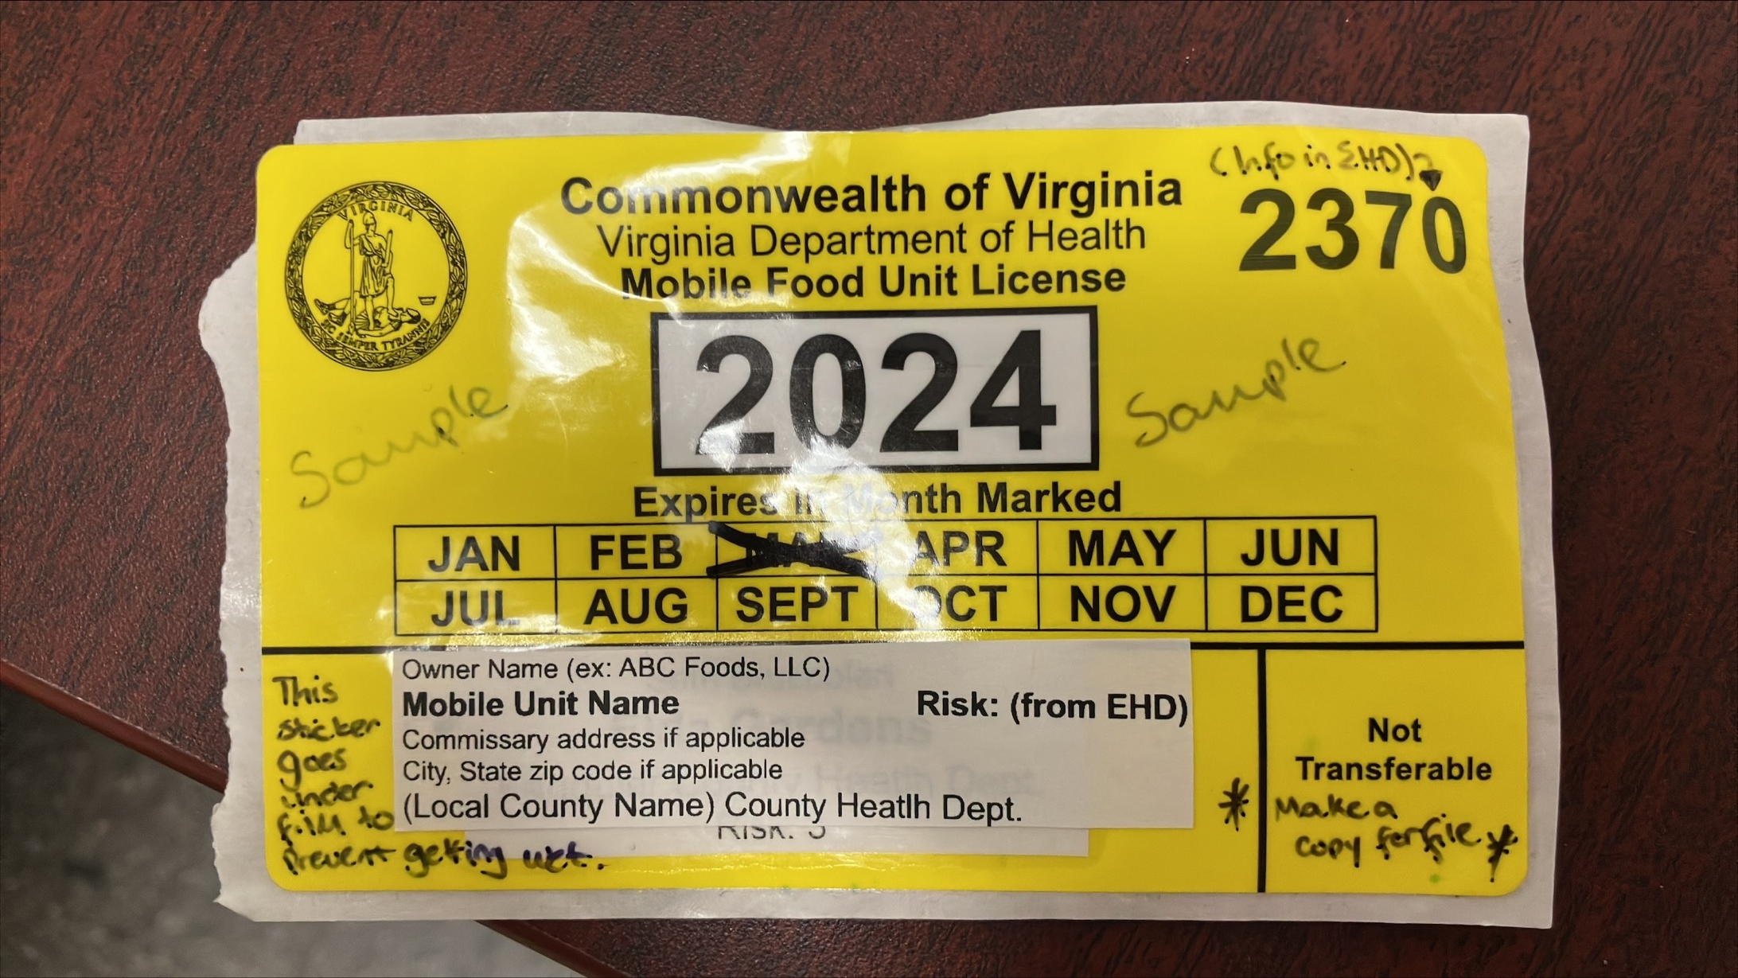
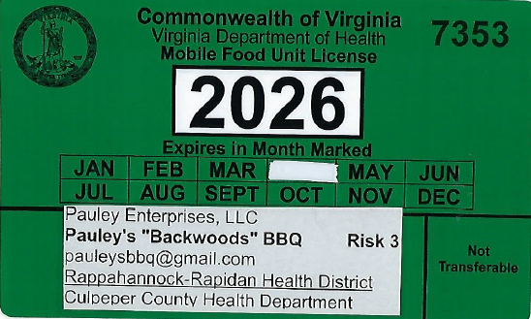
Mobile food unit:
Inspections are conducted based on
risk category.
Permit is a sticker that is
adhered to the mobile unit.
Notes:
Speaker: Whitney Wright
Mobile Unit inspections, like brick-and-mortar food establishment inspections are done based on a risk assessment to determine the frequency.
I have mentioned several times today that Mobile Units have a permit sticker, On this slide you can see that the valid Mobile Unit stickers for this season are Red and Green (or to make it easy to remember Red for STOP and Green for GO) while at the bottom left you will see that the Yellow (Think Caution) stickers are now expired. On the sticker, you can see the Month of expiration and Year the permit expires. Under that you will find other contact information related to the Mobile Unit and the Local Health Department Name where the Mobile Unit was permitted. This information is helpful should you wish to lookup the inspection history for the Mobile Unit or who to contact with question related to the permit.
Again, these permit stickers should be in plain view from where the public is served.

Slide 13

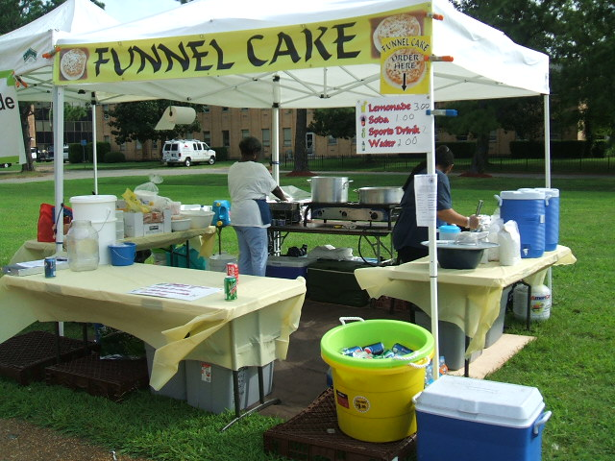
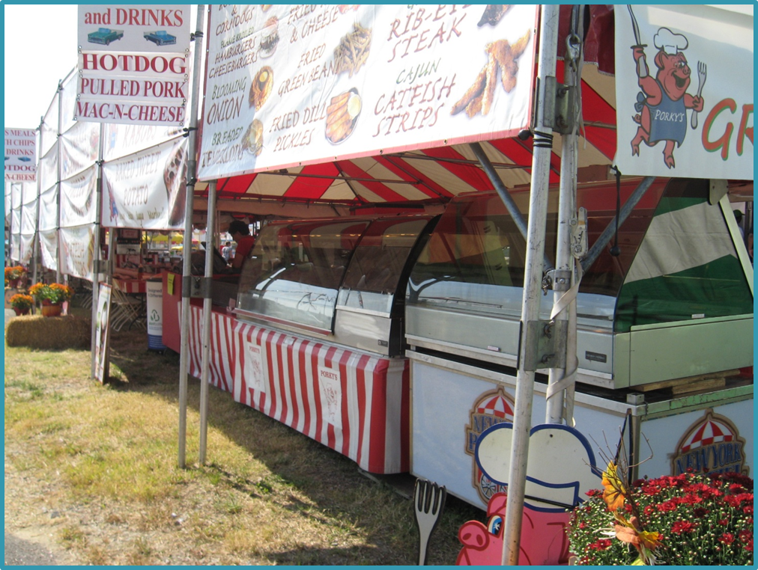
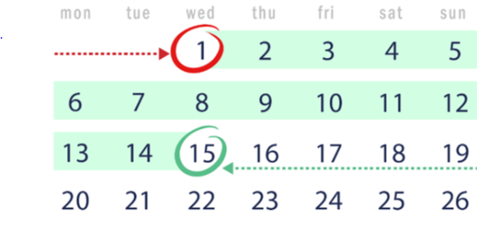
Temporary food establishment:
A food establishment that operates for a period
of no more than 14 consecutive days in conjunction
with a single event or celebration.
Inspections are conducted based on risk category
Notes:
Speaker: Whitney Wright
Our last VDH category of permit and probably the most common you will find at Farmers Markets is the Temporary Food Establishments or TFE’s
In our Virginia Food Regulations, a TFE is defined as a food establishment that operates for a period of no more than 14 consecutive days in conjunction with a single event or celebration.
TFE’s are also inspected based on risk assessment and typically are inspected ahead of first service.

Slide 14
An application for a TFE permit must be submitted at least 10 days prior to the event.
We recommend you check with the local health department where the market is taking place prior to participating in the market since there may be additional local codes.
Permit may be issued for multiple occurrences of an event for up to one year
Permit must be posted where visible to the public
A food establishment with a valid VDH permit can operate as a TFE without an additional VDH permit and must post a copy of the permit.
Notes:
Speaker: Whitney Wright
Farmers Market Managers and Vendors should be aware that an application for a TFE permit must be submitted at least 10 days prior to the operation of the Farmers Market. This is very important to ensure that TFE vendors provide the Local Health Department time to process their application, obtain any additional information that might be needed, and to plan for any inspections that might be required ahead of operation.
We recommend checking with the Local Health Department where the Farmers Market is located, in advance, to discuss any additional requirements that might be subject to that location.
Permits for TFE’s are only valid for the specified permit period on the permit (up to 12 months) and is not transferable from person to person. Permits must be posted during operation at the event

Slide 15


All food preparation must occur
onsite at the TFE
Notes:
Speaker: Whitney Wright
TFE’s are required to have all food preparation occur onsite at the event and are required to have the Person in Charge (PIC) be a Certified Food Protection Manager (CFPM).
So, no food from home.

Slide 16
Most VDH Restaurant and TFE Permits look like this
Operator and dba
name
Type of Permit
Signature of LHD
who issued the permit and the locality name
Risk Category and Expiration Date
Notes:
Speaker: Whitney Wright
Here is an example of what a VDH TFE permit looks like. The permit must be posted where it can easily be seen by the public when operating and serving food. The permit will include the expiration date, name of the operator, type of permit, name of local health department, and risk category.
Now I am going to pass it over to Jessica to get into the operational requirements of VDH permitted food establishments and walk through some example scenarios. Jessica

Slide 17
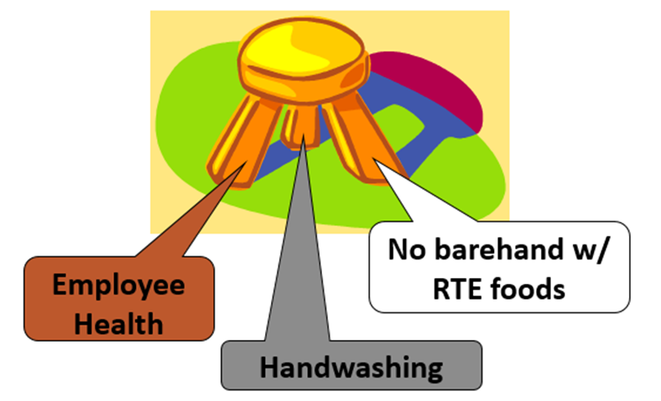
Operational Requirements for VDH Permitted Establishments
1) Person-in-Charge (PIC)
2) Certified Food Protection Manager (CFPM)
3) Food and water obtained from
approved sources—No Home Prepared Food
4) Employee practices/personal
hygiene
Employee health
Handwashing
No bare hand contact with RTE food
5) Cooking of raw animal foods-Use a thermometer
6) Holding temperatures of TCS food-cold food < 41*F, hot food >135*F
7) Clean/sanitized wares and surfaces
Notes:
Speaker: Jessica Klemencic
Regardless of what type of VDH permitted food vendor you are, there are operational requirements that apply:
1) You need to identify the Person-in Charge- or PIC. This is the person present at a food establishment who is responsible for the food service operation at the time of inspection.
2) Depending on your menu and processes ,you may need a Certified Food Protection manager or CFPM. The CFPM is an employee that has the authority to oversee and manage food preparation activities and food service and could be the PIC. To receive a CFPM certificate, the candidate must pass a test from one of the American National Standards Institute (ANSI) recognized programs. This credential demonstrates that they know what they need to about food safety regulations and safe food preparation and handling.
A TCS food is a food that requires time and temperature control for safety to limit the growth of harmful germs or toxins in the food.
Most VDH permitted food establishments are required to have at least one CFPM. The exceptions are food establishments that:
do not serve TCS foods, or
do not cook TCS foods, or
only reheat fully-cooked commercially processed foods, and/or
only cold hold commercially processed foods
If you are going to cook or cool any TCS foods, your operation will need a CFPM.
3) All food needs to come from approved sources. When we say approved sources, we mean a manufacturer of supplier that is inspected on a regular basis by a regulatory agency. If you aren’t sure your food suppliers are an approved source, please reach out to your LHD. I’ll explain how to do that later in the presentation.
4) Think of employee health and hygiene as a three-legged stool. Each leg represents an element that is essential to safe food handling practices:
Employee health,
Handwashing, and
No bare hand contact
If one leg isn't strong, the others won't work well either. These go hand-in-hand to prevent foodborne illnesses
5) The Virginia Food Regulations (modeled after the FDA Food Code) identify the proper time and temperatures for which various TCS foods need to be cooked to kill disease-causing germs. Your CFPM should know what these minimum temperatures are and should be monitoring and verifying the temperatures with a food thermometer.
6) Make sure cold food stays cold at or below 41* and hot food stays hot at or above 135*. This stops harmful germs from rapidly growing and making someone ill.
7) When utensils or equipment get dirty, they can transfer germs that can make you sick to the food. If utensils or equipment aren't cleaned and sanitized regularly, bits of old food are left on the utensils and equipment at room temperature allowing the bacteria in that old food to grow fast. If ready-to-eat food touches those dirty utensils or equipment, the food can get contaminated too.

Slide 18
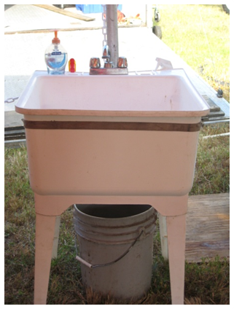
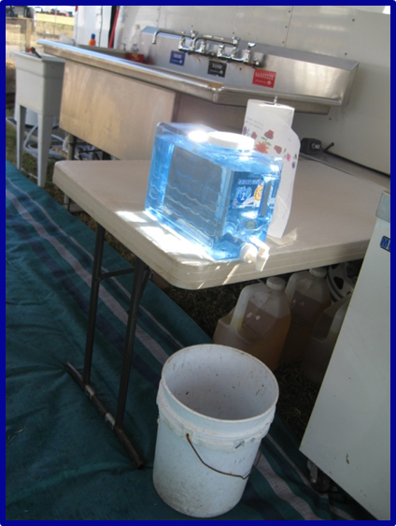
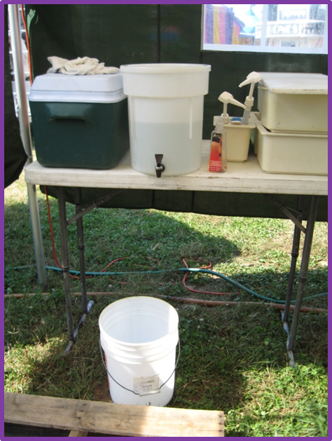
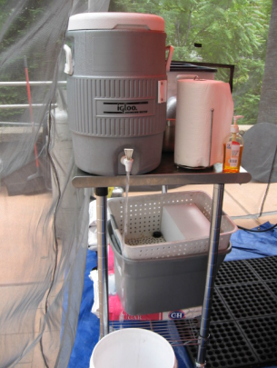
Examples of TFE Handwashing
Notes:
Speaker: Jessica Klemencic
Hand wash stations come in many shapes and forms, but they all include:
A gravity-fed container with a spigot filled with warm water (from an approved source)
A catch bucket to keep the dirty water from falling on the ground
Hand soap
Paper towels

Slide 19
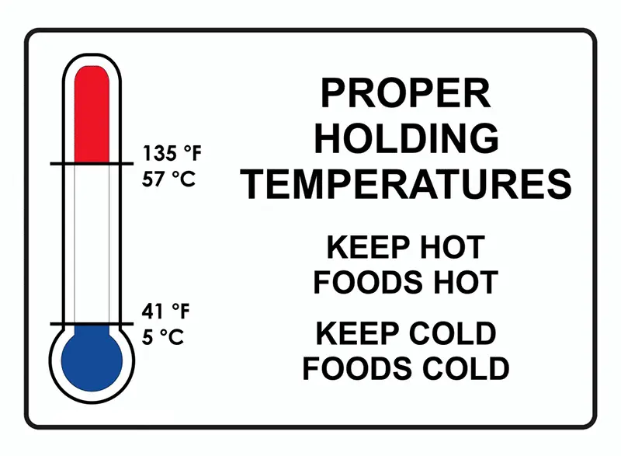
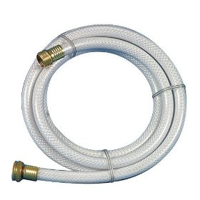
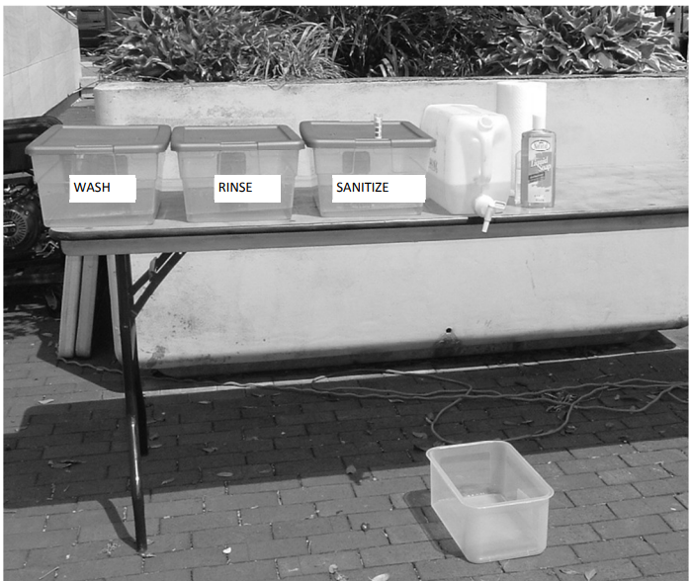
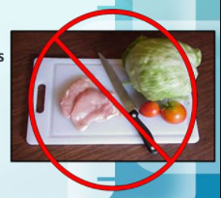

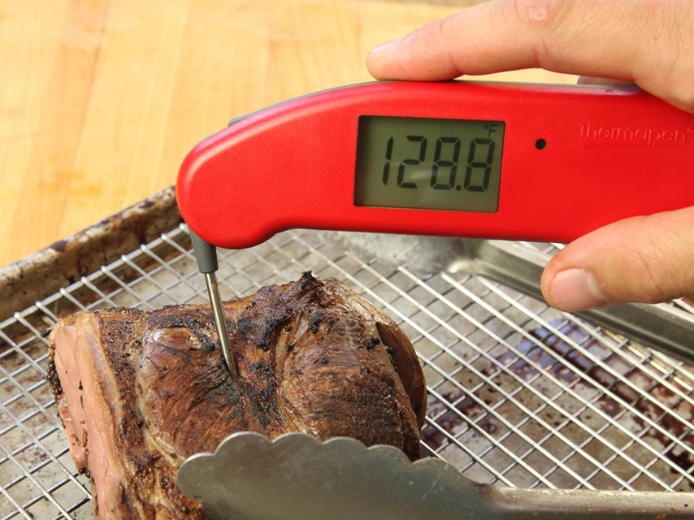
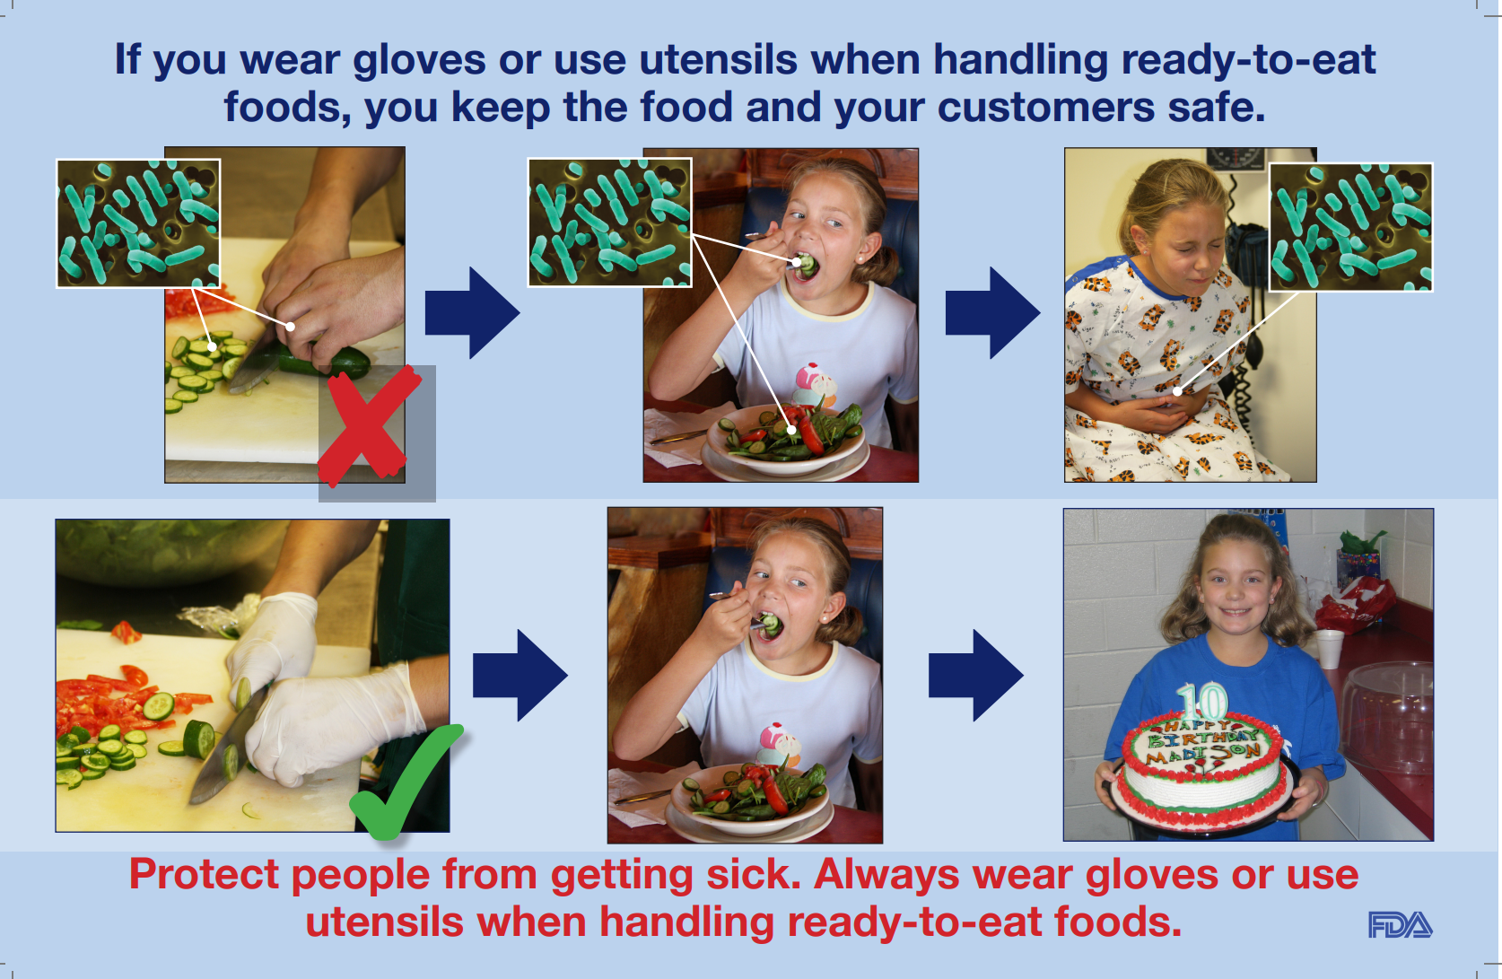
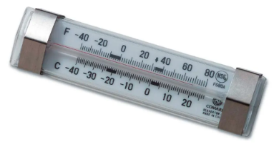
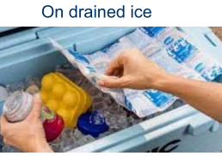
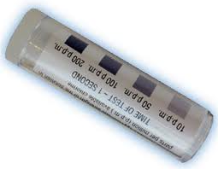
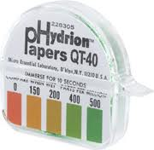
Notes:
Speaker: Jessica Klemencic
This slide provides a visual of overview of the 5 risk factors for foodborne illness discussed in a previous slide.
The 5 risk factors for foodborne illness are:
Food from unapproved sources
make sure you have your receipts and invoices available
Food includes water—use approved water hose—green garden hoses are not acceptable, they need to be food grade
Improper employee health and hygiene
do not work when you are sick
wash your hands after changing tasks
Change gloves when they become dirty or torn and wash your hands before putting new gloves on
Improper holding temperatures (hot and cold holding)
use a thin-tip probe thermometer to check your food temperatures
keep thermometers in your cooler or refrigerator at the warmest location to easily monitor the temperature
Improper cooking temperatures
use a thin-tip probe thermometer to check your food temperatures
Dirty and /or contaminated utensils and equipment
wash, rinse, and sanitize food contact surfaces
check your sanitizer concentration using the appropriate test strip
prevent cross contamination of ready-to-eat foods
prevent contamination of clean utensils and equipment

Slide 20
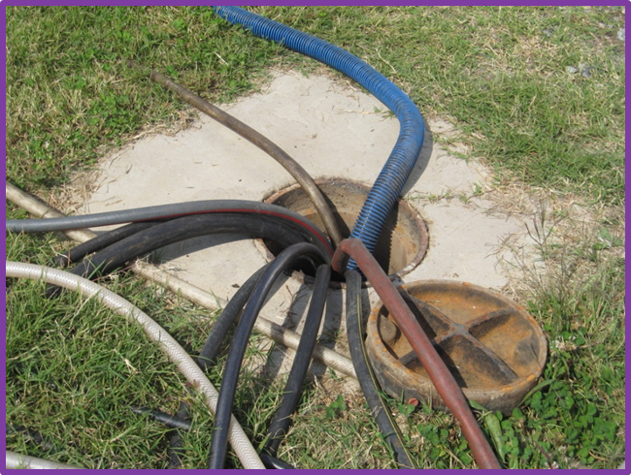
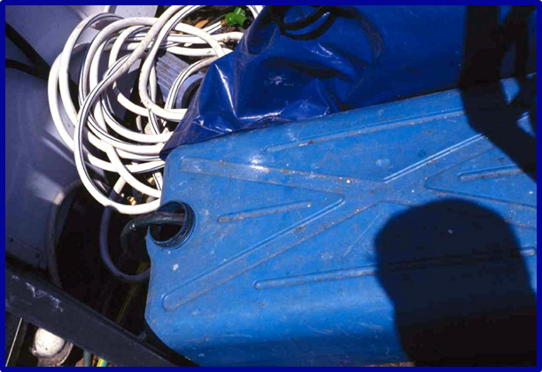
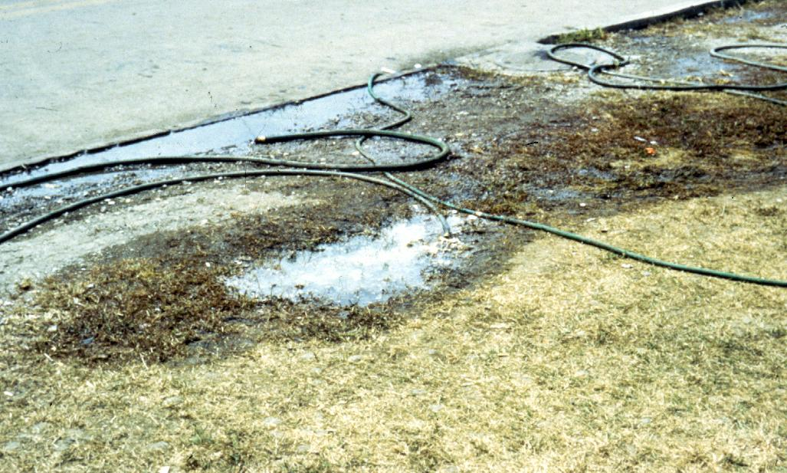
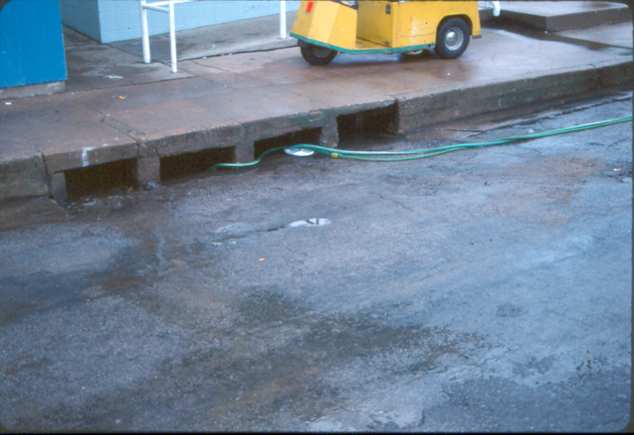
Wastewater Disposal
Notes:
Speaker: Jessica Klemencic
Dispose of your wastewater properly—do not dispose on the ground or in a storm drain
Check with your market manager/coordinator to see if they are providing wastewater disposal.
Approved methods of disposal include:
through a sanitary sewer connection or
approved wastewater tanks collected by an approved wastewater disposal company

Slide 21
TFE Permitting Process Scenario #1
Whitney wants to sell tacos at his local farmers market. What does he need to do?
Contact the LHD—they will provide him with the TFE application and walk Whitney through the process
Complete the TFE application and pay $40 state fee (local fees may apply) at least 10 days prior to participating in a farmers market
Keep the receipt of the $40 state fee payment
Here are some tips for Whitney when filling out his application:
Know the name and location of the farmers market
Know who the Market Coordinator is and have their contact information (i.e., name, phone number, email)
Know the dates of the farmers market (This is the date range which you plan to operate)
Know what foods will be on his menu (Any food for sale must be on the menu)
Have a copy of his (or his staff's) CFPM certificate available (They must be on site at the farmers market during operation)
Notes:
Speaker: Jessica Klemencic
Contact the LHD: not all LHD’s use the state application and there may local requirements specific for events like farmers markets
The $40 fee covers you for the calendar year. You may be required to complete new applications, but not pay the fee to participate in multiple farmers market
The dates of operation could be a single farmers market or could be multiple farmers markets or a market with multiple dates e.g. RVA Big Market at Bryan Park is a weekly market occurring throughout the summer and winter.
Menu: Make sure you put all the foods you want to sell/prepare on your menu. You can’t add items to the menu the day of the farmers market. Unapproved food cannot be sold.

Slide 22
TFE Permitting Process Scenario #2
Whitney obtained a TFE permit for selling tacos last month from Richmond City Health Department (HD) and has decided he would like to participate in a farmers’ market in Virginia Beach. What does he need to do?
If the permit has not expired:
Contact the Virginia Beach HD, provide them with a copy of his TFE permit issued by Richmond City HD, his most recent VDH inspection report, and let them know he is planning to participate in a farmers’ market in Virginia Beach.
Virginia Beach HD will determine if any additional steps are needed.
If the permit is expired:
Contact Virginia Beach HD, they will provide him with the TFE application and walk him through the process again. He should also provide a copy of his receipt from Richmond City HD to avoid any additional state fees if it's within the calendar year.
Notes:
Speaker: Jessica Klemencic

Slide 23
To Our Market Managers and Coordinators
We are here to help you have a successful market! Here are some points to consider:
Some localities have local ordinances with more stringent requirements than the State Food Regulations
Some localities have local Event Coordinator forms to complete
Do not hesitate to contact us with your questions
How can you help us?
Work with the local health department when organizing your market:
Let us know when and where the market will open in advance. Keep in mind VDH TFE vendors need to apply for a permit at least 10 days prior to their participation in the farmers’ market
Provide your list of vendors so we can determine who is exempt, who needs permitting, and who requires a CFPM
Request the vendor or farmer to provide you with a copy of their VDH or VDACS permit
Notes:
Speaker: Jessica Klemencic

Slide 24
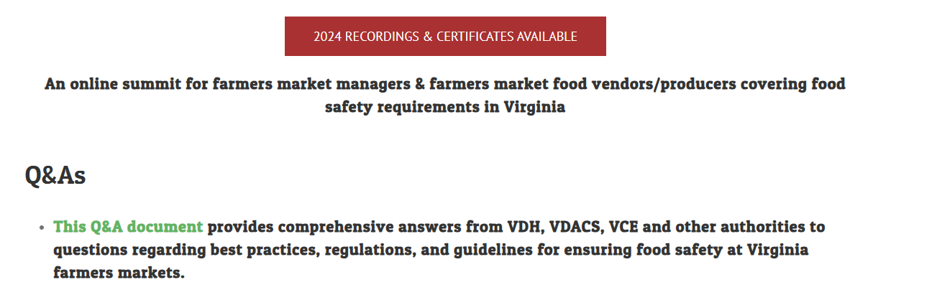
Frequently Asked Questions
Virginia Farmers Market Food Safety Summit – Virginia Farmers Market Association
Notes:
Speaker: Jessica Klemencic
We’ve covered a lot of information today and you may have more questions that did not get answered today.
VAFMA compiled questions and answers received from last year’s summit into a comprehensive FAQ document which can be found by visiting their website at the link provided.

Slide 25
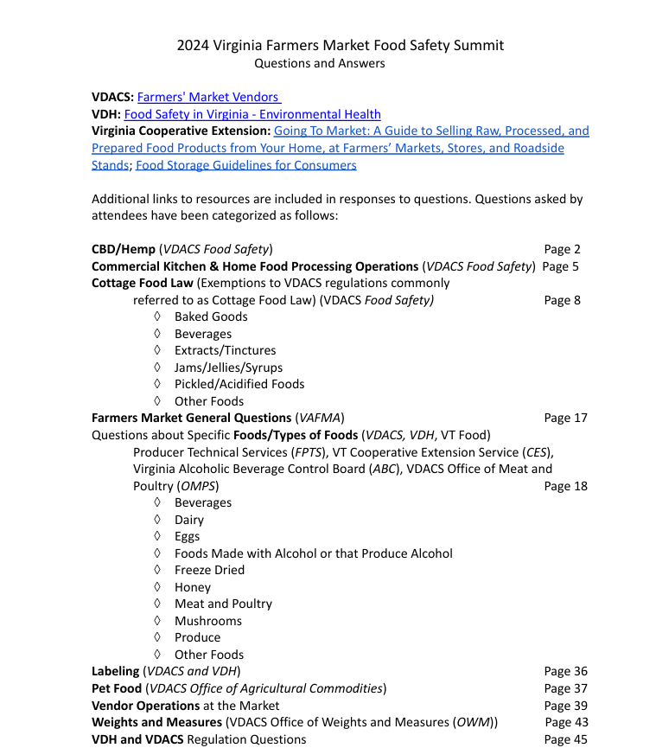
Notes:
Speaker: Jessica Klemencic
Here is a screenshot of the table of contents

Slide 26

Notes:
Speaker: Jessica Klemencic
There are a few ways to locate a local health department

Slide 27
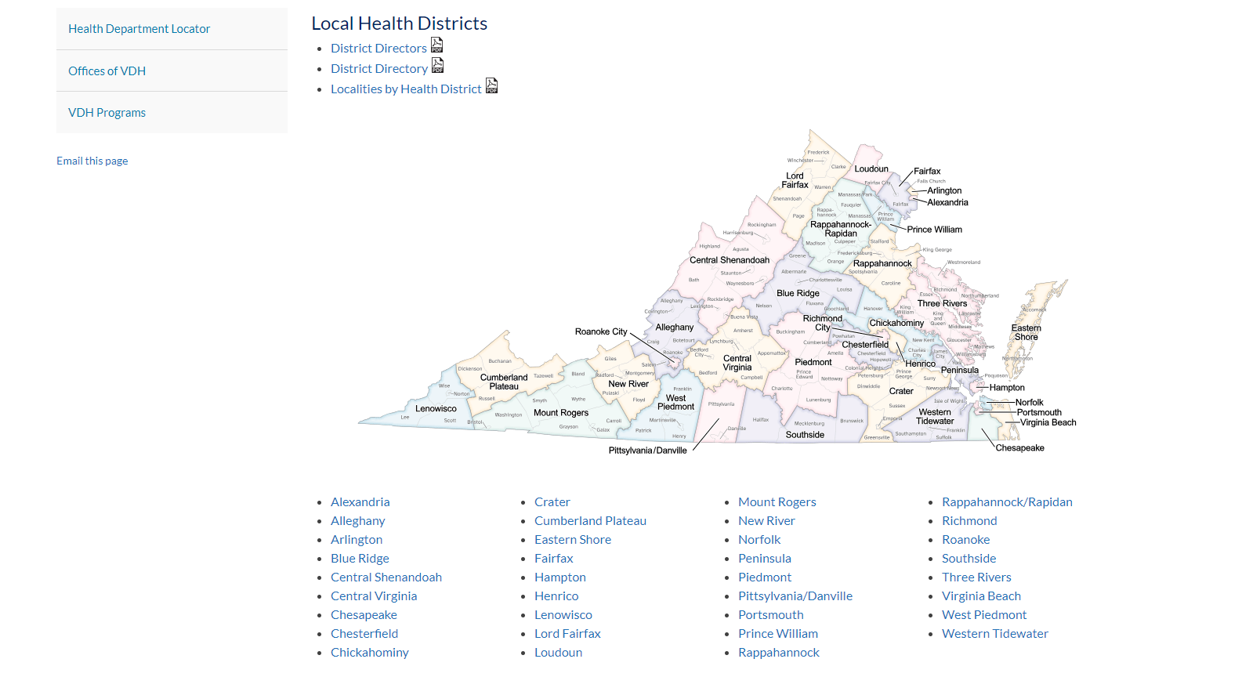
How can we help you?
Do not hesitate to contact us for any questions you may have
Refer to our resources slide at the end of this presentation
Notes:
Speaker: Jessica Klemencic
This is what our “Local Health Districts” page looks like (the link is provided on our resources slide at the end of this presentation)
You can find your local health department one of two ways:
Use the health department locator tool (circled in orange), or
Refer to the map and click on the local health district name. Once you enter the LHD page, click on the “Environmental Health” or “Food Safety” link

Slide 28
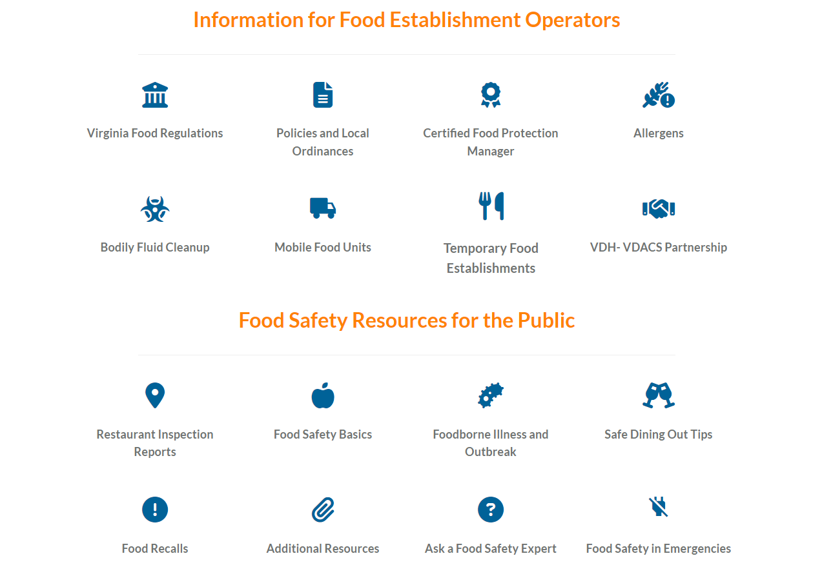
Food Safety in Virginia - Environmental HealthFood Establishment
Notes:
Speaker: Jessica Klemencic
When you visit our Food Safety in Virginia website, this is what our main landing page looks like.
You can find information that includes Policies and Local Ordinances, TFE, Mobile Units, and the VDACS-VDH MOU

Slide 29
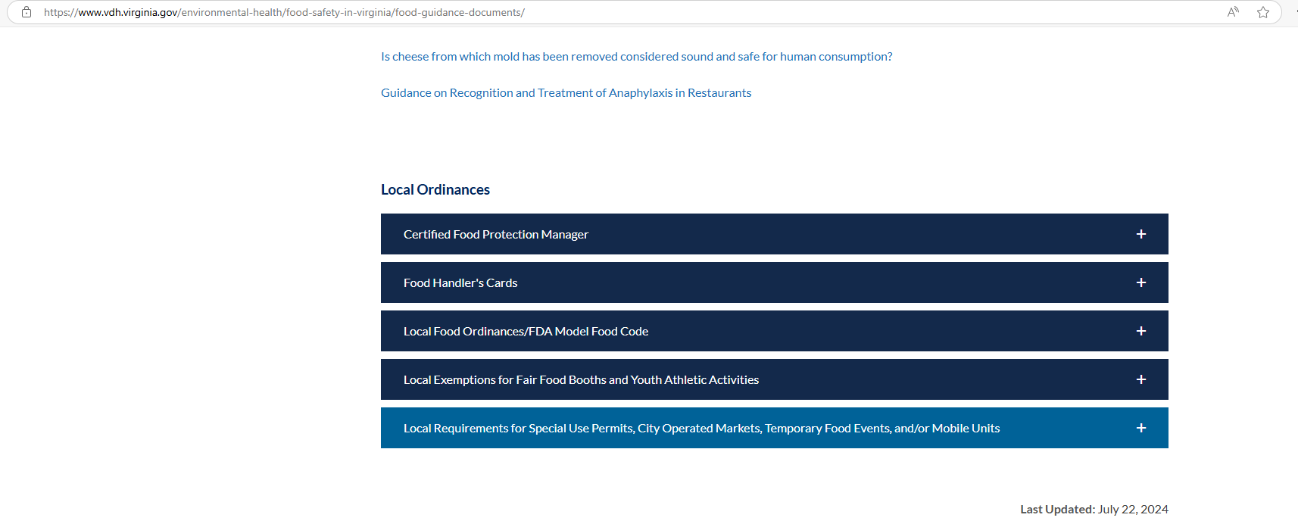
Policies and Local Ordinances
https://www.vdh.virginia.gov/environmental-health/food-safety-in-virginia/
Notes:
Speaker: Jessica Klemencic
This slide indicates what localities have local requirements for TFE and Mobile units and is on under “Policies and Local Ordinances”

Slide 30

Notes:
Speaker: Jessica Klemencic
This QR code will take you directly to our TFE webpage.

Slide 31
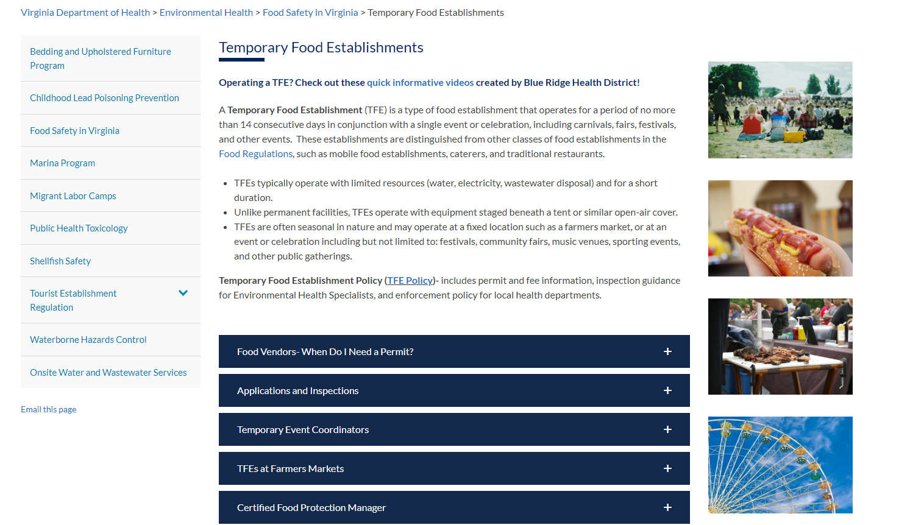
Notes:
Speaker: Jessica Klemencic
This is what it looks like

Slide 32

Notes:
Speaker: Jessica Klemencic
This QR code will take you to the VDH-VDACS MOU

Slide 33
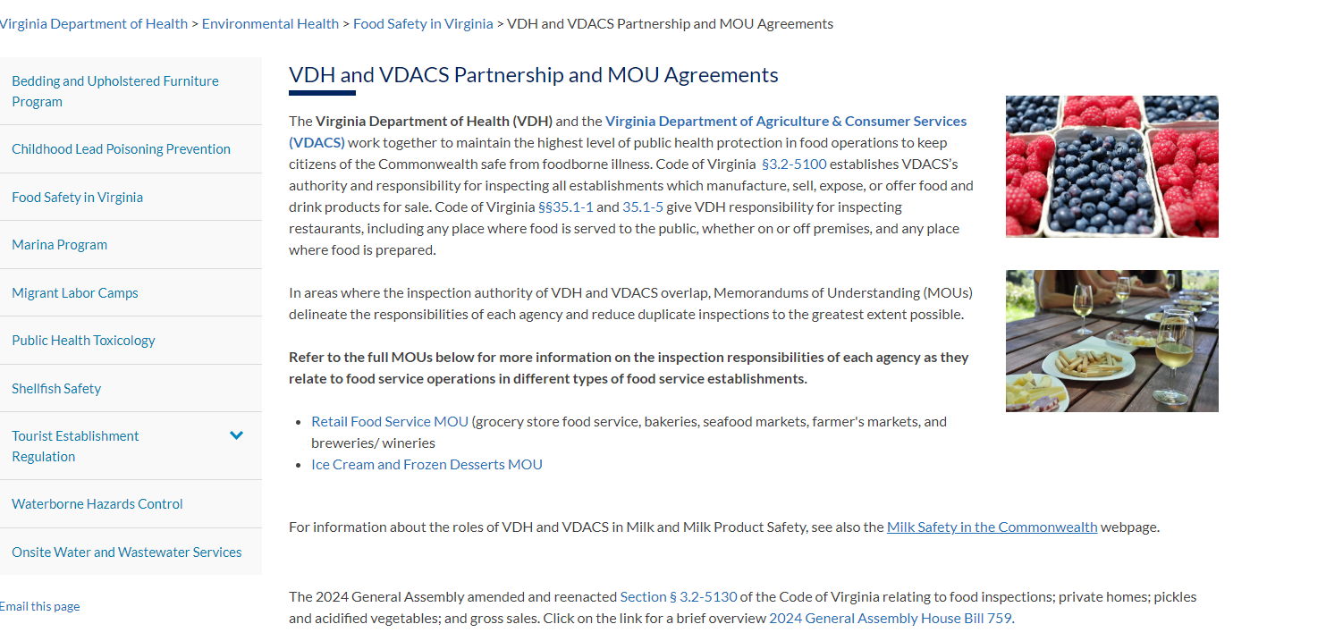
Notes:
Speaker: Jessica Klemencic
This is what the page looks like

Slide 34
Code of Virginia
VDACS:
§ 3.2-5130. Inspections required to operate food establishment.
VDH:
§ 35.1-14. Regulations governing restaurants; advisory standards for exempt entities.
Notes:
Speaker: Whitney Wright
These are the links to see the exemptions to the VDACS food regulations and the VDH food regulations.

Slide 35
VDH List of Resources for Vendors
Main Food Safety Landing Page: Food Safety in Virginia - Environmental HealthFood Establishment
Operators Information - Environmental Health (virginia.gov)
How to apply for food permit including mobile units and temporary food establishments (TFE)
Certified Food Protection Manager (CFPM) information
List of Localities that have local ordinances or additional requirements for TFEs
Employee Health
Food Regulations
Food Allergen Awareness
VDH and VDACS Memorandum of Understanding: VDH and VDACS Partnership and MOU Agreements - Environmental Health (virginia.gov)
Find your Local Health District:
Main Landing Page: Local Health Districts - Virginia Department of Health
Health Department locator: Health Department Locator - LHD Locator (virginia.gov)
Contact us at: foodsafety@vdh.virginia.gov
Notes:
Speaker: Whitney Wright
These are the links to see the exemptions to the VDACS food regulations and the VDH food regulations.

Slide 36
Thank you!
Virginia Department of Health, Division of Food and General Environmental Services
Whitney Wright, Environmental Health Coordinator
Whitney.Wright@vdh.virginia.gov
Jessica Klemencic, Food Safety Quality Assurance Coordinator
Jessica.Klemencic@vdh.virginia.gov
Notes:
Speaker: Whitney Wright

Slide 37

Questions?
Contact us at: foodsafety@vdh.virginia.gov
Notes:
Speaker: Whitney Wright & Jessica Klemencic
If you have questions, please don’t hesitate to contact us at the food safety inbox.
Please feel free to send us suggestions if you feel we missed a topic so we can review for next year

