Slide 1
Food Safety Summit
April 28, 2025
Virginia ABC

Slide 2
COV Definition of an Alcoholic Beverage
§ 4.1-100. Definitions.
"Alcoholic beverages" includes alcohol, spirits, wine, and beer, and any one or more of such varieties containing one-half of one percent or more of alcohol by volume, including mixed alcoholic beverages, and every liquid or solid, powder or crystal, patented or not, containing alcohol, spirits, wine, or beer and capable of being consumed by a human being.

Slide 3
Exemptions to Licensure (§ 4.1-200)
The manufacture, sale and delivery or shipment by persons authorized under existing laws to engage in such business of any medicine containing sufficient medication to prevent it from being used as a beverage.
The manufacture, sale and delivery or shipment by persons authorized under existing laws to engage in such business of any medicinal preparations manufactured in accordance with formulas prescribed by the United States pharmacopoeia; national formulary, patent and proprietary preparations; and other bona fide medicinal and technical preparations; which contain no more alcohol than is necessary to extract the medicinal properties of the drugs contained in such preparations, and no more alcohol than is necessary to hold the medicinal agents in solution and to preserve the same, and which are manufactured and sold to be used exclusively as medicine and not as beverages.
The manufacture, sale and delivery or shipment of toilet, medicinal and antiseptic preparations and solutions not intended for internal human use nor to be sold as beverages.
The manufacture and sale of food products known as flavoring extracts which are manufactured and sold for cooking and culinary purposes only and not sold as beverages.
  Includes bitters and vanilla

Slide 4
Exemptions to Licensure (§ 4.1-200) Cont.
Any person who manufactures at his residence or at a gourmet brewing shop for domestic consumption at his residence, but not to be sold, dispensed or given away, except as hereinafter provided, wine or beer or both, in an amount not to exceed the limits permitted by federal law.
Any person who manufactures wine or beer in accordance with this subdivision may remove from his residence an amount not to exceed fifty liters of such wine or fifteen gallons of such beer on any one occasion for (i) personal or family use, provided such use does not violate the provisions of this subtitle or Board regulations; (ii) giving to any person to whom wine or beer may be lawfully sold an amount not to exceed (a) one liter of wine per person per year or (b) seventy-two ounces of beer per person per year, provided such gift is for noncommercial purposes; or (iii) giving to any person to whom beer may lawfully be sold a sample of such wine or beer, not to exceed (a) one ounce of wine by volume or (b) two ounces of beer by volume for on-premises consumption at events organized for judging or exhibiting such wine or beer, including events held on the premises of a retail licensee. Nothing in this paragraph shall be construed to authorize the sale of such wine or beer.

Slide 5
Permits Needed – Industrial Alcohol
The board may issue a yearly permit authorizing the shipment and transportation direct to the permittee of orders placed by the board for alcohol or other alcoholic beverages for any of the following purposes:
    1. For industrial purposes;
    2. For scientific research or analysis;
    3. For manufacturing articles allowed to be manufactured under the provisions of § 4.1-200 of the Code of Virginia;
    4. For use in a hospital or home for the aged (alcohol only).
Applications for alcohol shall be accompanied by a fee of $10, where the order is in excess of 110 gallons during a calendar year, or a fee of $5.00 for lesser amounts. Applications for other alcoholic beverages shall be accompanied by a fee of 5.0% of the delivered cost to the place designated by the permittee.
https://www.abc.virginia.gov/licenses/val/definitions/industrial-alcohol

Slide 6
Permits Needed – Grain Alcohol
The board may issue a yearly permit authorizing the permittee to purchase grain alcohol with a proof greater than 151 at government stores for any of the following purposes:
    1. Industrial use;
    2. Commercial use;
    3. Culinary use; or
    4. Medical use.
$50 (annual) fee/$50 application fee
https://www.abc.virginia.gov/licenses/val/definitions/grain-alcohol

Slide 7
Permits Needed – Culinary
Any person to keep upon his premises alcoholic beverages that he is not authorized by any license to sell and which shall be used for culinary purposes only.
$50 (annual) fee/$50 application
https://www.abc.virginia.gov/licenses/val/definitions/culinary-permit

Slide 8
Licenses
Confectionery licenses, which shall authorize the licensee to prepare and sell on the licensed premises for off-premises consumption confectionery that contains five percent or less alcohol by volume. Any alcohol contained in such confectionery shall not be in liquid form at the time such confectionery is sold.
Pursuant to 4.1-203, each license granted by the Board shall designate the place where the business of the licensee will be carried on. Except as otherwise provided in §§ 4.1-206.1, 4.1-206.2, and 4.1-206.3, a separate license shall be required for each separate place of business.
$170 (annual)fee/$195 application

Slide 9
Market Premises
Licenses
Retail off-premises(beer & wine to-go) wine and beer licenses, which may be granted to a convenience grocery store, delicatessen, drugstore, gift shop, gourmet oyster house, gourmet shop, grocery store, or marina store.
Such license shall authorize the licensee to sell wine and beer in closed containers for off-premises consumption.
To give to any person to whom wine or beer may be lawfully sold a sample of wine or beer for on-premises consumption; however, no single sample shall exceed four ounces of beer or two ounces of wine and no more than 12 ounces of beer or five ounces of wine shall be served to any person per day. The licensee may also give samples of wine and beer in designated areas at events held by the licensee for the purpose of featuring and educating the consuming public about the alcoholic beverages being tasted.
On-premises establishments.
  Mixed Beverage
  Hotels, restaurants, and clubs

Slide 10
Wineries, Farm Wineries, Breweries Distilleries
Farm Wineries – Remote Privileges
Must have a remote.
Sell wine for off premises consumption.
Sell wine for on-premises consumption (designated area only).
Distilleries – Remote Privileges
Must have a remote. Must be at an event licensed by the board for the purpose of featuring and educating about alcohol.
Sell distilled spirits for off premises consumption.
Sell/give away samples of spirits for on-premises consumption (designated area only).

Slide 11
Wineries, Farm Wineries, Breweries Distilleries Cont.
If the market has a VA ABC License, manufacturers cannot receive a remote.
If there is a charge to attend the market for patrons, manufacturers may not be able to be present and obtain a remote.
Manufacturers may not donate alcoholic beverages.
Sponsorships - Alcoholic beverage advertising in connection with the sponsorship of public events shall be limited to sponsorship of conservation and environmental programs, professional, semi-professional, or amateur athletic and sporting events and events of a charitable or cultural nature by distilleries, wineries, breweries, importers, and bottlers
Manufacturers may participate to provide educational material and information about their businesses.

Slide 12
Wineries, Farm Wineries, Breweries Distilleries Cont.
If there are questions regarding a manufacturer of alcoholic beverages attending a market or event, please contact the compliance unit.
  https://www.abc.virginia.gov/enforcement/bureau-of-law-enforcement/compliance-unit
  compliance@virginiaabc.com
  (804) 213-4632

Slide 13
Contact Information
Special Agent in Charge - Compliance
Marc Haalman
marc.haalman@virginiaabc.com
(804)213-4626

Slide 14
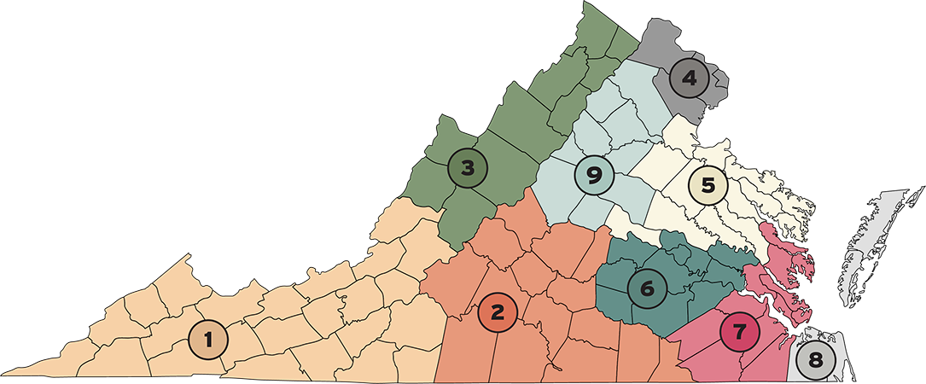
Contact Information
https://www.abc.virginia.gov/enforcement/bureau-of-law-enforcement/regional-offices

Slide 15
Questions?

