Slide 1
Requirements to sell Pet Treats in Virginia
Caroline Wilkinson
Virginia Department of Agriculture and Consumer Services
Agricultural Commodity Program

Slide 2
Requirements
FEES
REGISTRATION FORMS
TONNAGE
MANUFACTURING
LABELING

Slide 3
FEES
Commercial Feed License
Licensing year is January 1st – December 31st
  License = $50 per year
Product Registrations
Registration year is the same a licensing, January 1st – December 31st
  Small Package Product Registration = $50 per product per year
  See Product Registration Form for Alternative Product Pricing

Slide 4
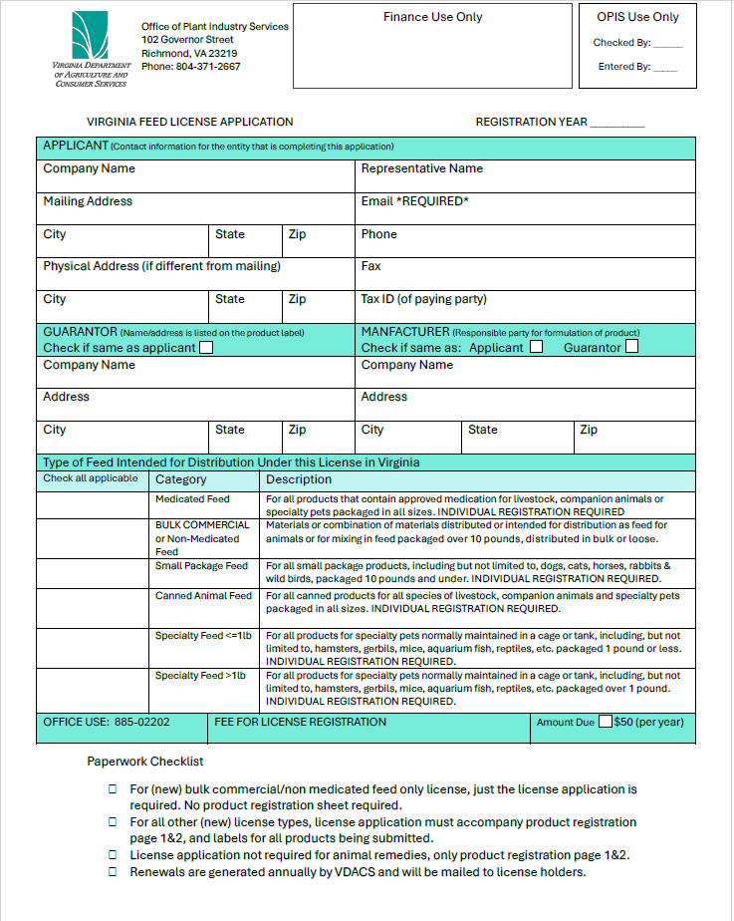
License Registration FORM
A downloadable version of the registration packet, which includes the license registration and product registration forms, is available at:
https://www.vdacs.virginia.gov/pdf/reg-feed.pdf

Slide 5
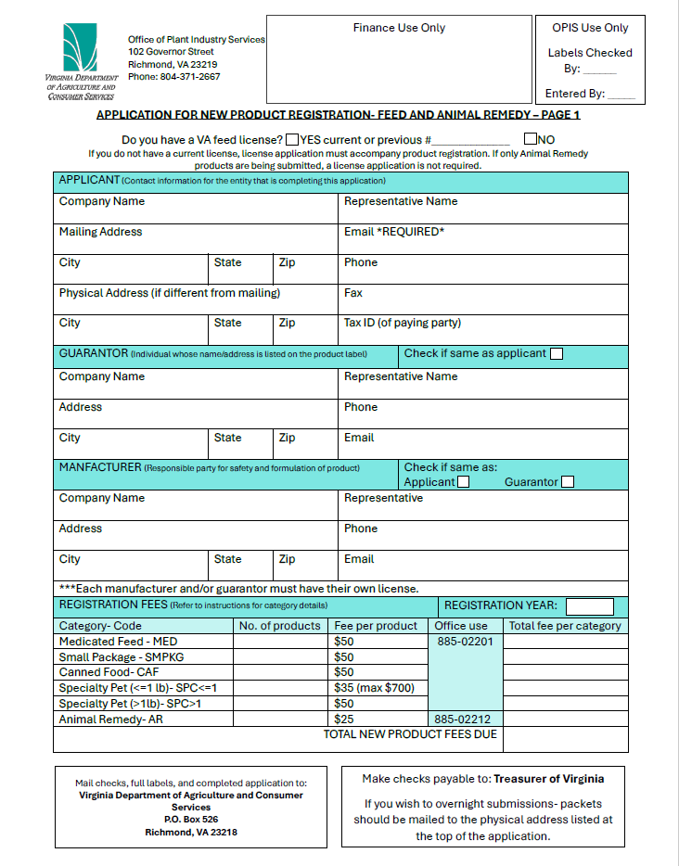
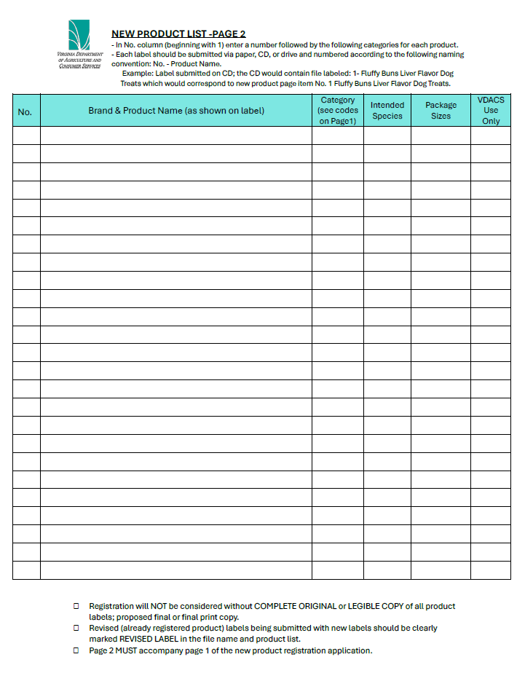
Product REGISTRATION Form
Both pages should be completed and sent with full copies of labels for review.
Labels sent must be legible and correspond to the name found on the product list.

Slide 6
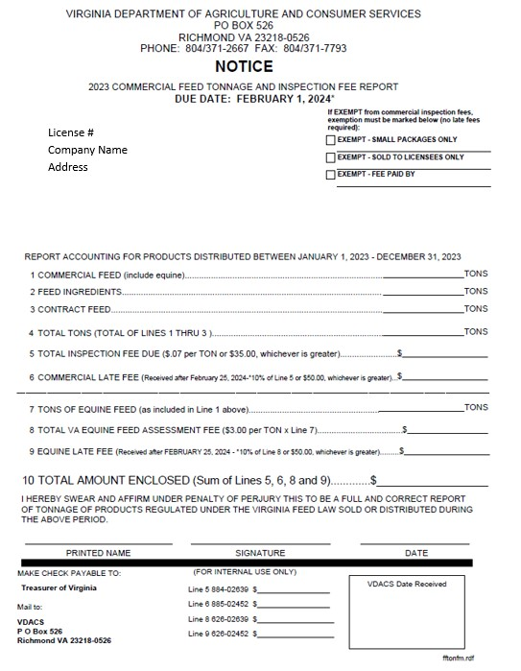
Tonnage
What is it?
  Feed, nutritional supplements and treats sold bulk, loose or in packages greater than ten pounds.
    Ex. Cookie Bar – Customers choose product and pay by the lb.
When is it due?
  Tonnage reports are due February 1st. VDACS will mail tonnage reports annually in December
Do I have to file if I mark exempt?
  Yes. When only selling prepackaged registered pet treats, you will mark: EXEMPT – SMALL PACKAGES ONLY.
  Print name, sign, date and return the form to our office. Do not fill out the reporting section.
EXCEPTION
  If you sell BOTH registered small package product less than 10lbs AND products over 10lbs/bulk/loose, then you DO NOT mark exempt.
    Record the amount of tonnage of products over 10lbs.
    Minimum fee due of $35.
    Sign, date, include fee and return to address listed.

Slide 7
Manufacturing
Pet Treats can be manufactured in a home kitchen.
An inspection prior to manufacturing is not required, but we are allowed by §3.2-4809 to conduct an inspection.
When manufacturing, be sure to follow the U.S. Food and Drug Administration’s Current Good Manufacturing Practices (CGMPs)
  These can be found through an online search of 21 CFR Part 507 Current Good Manufacturing Practices for Animal Food.

Slide 8
Labeling
We review all small packaged feed labels prior to registration.
From our law:
§ 3.2-4804. Product registration required of commercial feed distributors. D. Every manufacturer or guarantor of small package commercial feed shall: (i) apply for registration for each small package commercial feed on forms furnished or approved by the Commissioner; (ii) pay a registration fee of $50 to the Commissioner by January 1 per small package commercial feed, in lieu of an inspection fee for this size package; and (iii) submit a copy of any label, used or proposed to be used with the small package commercial feed for approval with the registration form.

Slide 9
Label Requirements
Brand Name
Millie’s Cat Crunchies
Sweet Potato Biscuits
Kind of pet
Dog, cat, horse, etc. – the species the treat is manufacturer for must be written on the front of the label, if not a part of the brand name.

Slide 10
Label Requirements
Quantity
statement
Expressed as weight for solid products (avoirdupois) or volume for liquid products in U.S. and metric equivalent.
  Net weight 8 oz. (227 g)
  Net volume 12 FL. OZ. (355 mL)
  Both measurements must be present.

Slide 11
Label Requirements
Ingredient statement
A continuous list of each approved ingredient using the name of the ingredient adopted by AAFCO.
Ingredients shall be listed in descending order of predominance by weight.
If there is no designated name adopted by AAFCO, use the common name of the product such as ‘sugar’, ‘butter’, etc.
Ingredients:
Peanut butter, flour, butter, cinnamon
Ingredients:
Sweet potato, flour, egg, sugar
Ingredients:
Blueberries, sweet potato, flour, egg
CBD, Hemp, and THC are not allowed in feed products with a nutritional guaranteed analysis.

Slide 12
Label Requirements
Guaranteed Analysis
This must include the correct heading and include (at a minimum) the following components stated in the order and format listed below:
    Crude protein (min) -- XX%
    Crude fat (min) -- XX%
      (If labeled as ‘low or reduced’ fat, also include: Crude fat (max) -- XX%
    Crude fiber (max) --- XX%
    Moisture (max) --- XX%
    All additional or voluntary guarantees must be listed thereafter in the appropriate format with appropriate units.
Guaranteed Analysis
Crude Protein(min) 10%
Crude Fat (min) 2%
Crude Fiber (max) 5%
Moisture (max) 12 %

Slide 13
Label Requirements
Calorie Content
The label of a dog or cat food, including snacks, treats, and supplements, shall bear a statement of calorie content and meet all of the following:
  The statement shall be separate and distinct from the "Guaranteed Analysis" and appear under the heading "Calorie Content"
  The statement shall be measured in terms of metabolizable energy (ME) on an “as fed’ basis and must be expressed, in either the words "metabolizable energy" or the abbreviation "ME", both as “kilocalories per kilogram” (“kcal/kg”) of product, and as “kilocalories per familiar household measure (e.g., cans or cups) or unit of product (e.g., treats or pieces)”
  Both values must be present.
SWEET POTATO TREAT
Ingredients: Sweet potato, flour, butter, sugar
Guaranteed Analysis To be fed as a snack or Crude Protein (min) 4% treat for small dogs.
Crude Fat (min) 6%
Crude Fiber (max) 4%
Moisture (max) 12%
Calorie Content (ME) 125 kcal/kg
25 kcal/treat
ABC Treats, Dogtown, VA
ABCTreats@gmail.com
Net Weight 8 oz. (227 g)

Slide 14
Label Requirements
NUTRITIONAL ADEQUACY STATEMENT
If the product is clearly identified on the front label as a snack or treat, a nutrition statement or purpose statement is not required.
MANUFACTURER/ GUARANTOR
As the manufacturer or guarantor of the product, your name and mailing address is required to be on the label.
At a minimum, the: Company Name, City, State, Zip
Name and address of guarantor/manufacture of the feed should be the same as on your feed license.​
E-mail address may be present, but not a substitute for location address.

Slide 15
Label Requirements
Claims must be truthful and are subject to substantiation requests. **This includes claims on websites**
Examples of Claims
  Whitens teeth, freshens breath, etc.
      Dental claim needs to include the “mechanism” for the plaque and tartar removal. i.e. Chewing helps to scrape away plaque and tartar.
      Unless it can be substantiated, will not be allowed.
  Low calorie dog treats
    Must indicate in feeding directions how to feed to meet claim.
  Hairball control
    Not allowed on cat treats, only on complete feeds.
  Any claims that are intended for the "diagnosis, cure, mitigation, treatment, or prevention of disease in animals; (iii) other than food or cosmetics, intended to affect the structure or any function of the body of animals"…
      Are considered drug claims and are not allowed on pet feed or treats.

Slide 16

Label Example
Lucy’s Delicious Biscuits
Dog Treats
Ingredients: Blueberries, Sweet Potato, Flour, Egg
GUARANTEED ANALYSIS
Crude Protein (min)4%
Crude Fat (min) 6%
Crude Fiber (max) 4%
Moisture (max) 12%
Calorie Content (ME) 125 kcal/kg; 25 kcal/treat
*To be fed as a snack or treat for small dogs.*
ABC Treats, Dogtown, VA
ABCTreats@gmail.com
Net Weight 8 oz. (227 g)

Slide 17
Questions
Do I need a business license in addition to the Commercial Feed License?
  It depends on your city/county. Please reach out to them.
Do the cottage laws apply to animal food?
  No, animal food (includes pet treats), does not fall under the cottage laws. You will need to license and register your products with the VDACS Agricultural Commodities Program (ACP).
What is the CHEW exemption?
  VDACS follows the guidelines set up by AAFCO on chews and they are exempt from registration.
  These products do not bear a calorie content or guaranteed analysis, nor any nutritional claims in labeling.
  Ex. All chews, bones, toys and exercisers made of animal skin, hide, wood or manmade materials, hooves, ears, animal bones, ligaments, snouts, pizzles
  Visit the AAFCO website for more info:
    Treats and Chews | AAFCO

Slide 18
Questions
Are dehydrated or freeze-dried chicken feet allowed without a commercial kitchen?
  If this is an animal food, yes.
Does pet food have to be at a certain temperature, what are the guidelines?
  It depends on the product. If it’s a temperature-controlled product i.e. frozen pup cup, it must be kept at a temperature to prevent adulteration.
How do you go about starting an onsite dog food company?
  Please find us on the VDACS Website or you can contact the Agricultural Commodities Program (ACP). We will provide you with the information and documents needed to become licensed and registered.

Slide 19
Questions
Where do you find insurance for starting a dog food company at a farmers’ market?
  Reach out to your insurance agent for help.
Can you sell pet food/snacks at more than farmers markets and wholesale without a commercial kitchen?
  Yes, you can sell animal food without a commercial kitchen but are still required to license and if applicable, register products.
Ground poultry as Pet Food i.e. Beef, Pork, Chicken, Turkey
  Yes, you can sell ground meat as a supplemental pet food, but it must be kept under conditions to prevent adulteration i.e. spoilage, contamination.

Slide 20
Thank you

