Slide 1
How do I prepare to sell at a farmer’s market?
Are you permitted by the right agency?
  VDH permits Grade “A” pasteurized products:
    Fluid Milk
    Yogurt
    Kefir
    Cottage Cheese
    Buttermilk
    Whey
  VDACS permits manufactured grade products:
    Cheese
    Ice Cream
    Dairy and Non-Dairy Frozen Desserts
    Cream Cheese
    Butter

Slide 2
How do I prepare to sell at a farmer’s market?
Must be permitted by VDACS Dairy Services or VDH (fluid milk)
  Or another state’s regulatory authority
Must be in good standing
No active recalls for products being sold at the market
New products must be sampled and held from sale until results are received back as negative for pathogenic growth, and within other safe regulatory levels

Slide 3
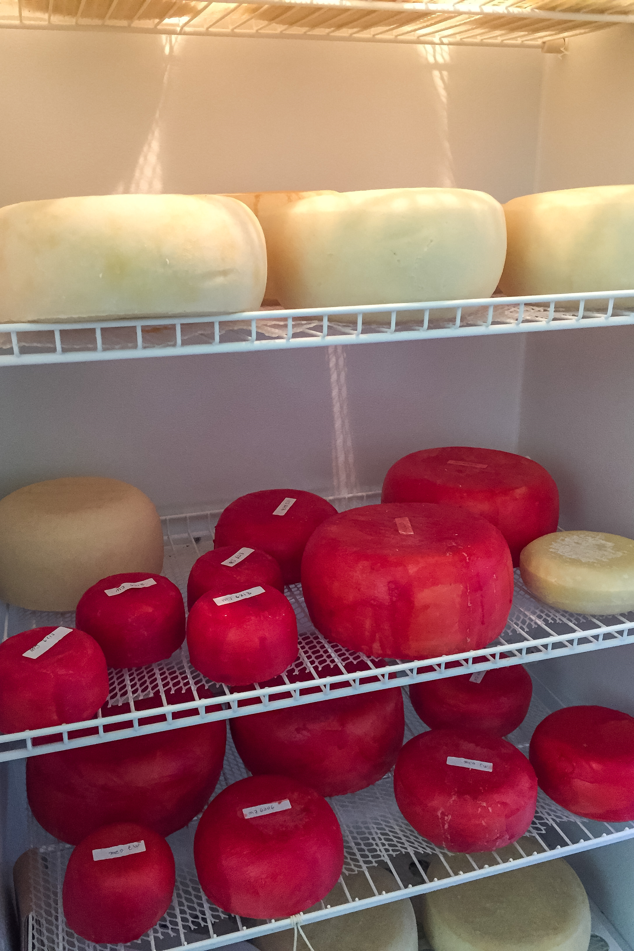
I’m finally set up at the Farmer’s Market!
Now what?
Almost all dairy products are considered a TCS (time/temperature control for safety) Food
  Must be held below 41° F; or
  Marked when taken out of refrigeration and sold, served, or destroyed within 4 hours.
    This pertains to free samples, too!

Slide 4

What dairy products can’t I sell?
2VAC5-490-75. Sale of unpasteurized milk for human consumption prohibited.
No person may offer to sell or sell, barter, trade, or accept any goods or services in exchange for unpasteurized milk if the unpasteurized milk is intended for human consumption.
Statutory Authority
§ 3.2-5206 of the Code of Virginia.
Notes:
So what can’t I sell??
A recent CDC study concluded that the consumption of raw milk is at least 150 times more likely to make a person ill when compared to the consumption of pasteurized milk.
Raw unpasteurized milk, just like raw chicken or raw meat has certain inherent risks, no matter how well it is handled until it reaches a kill step such as pasteurization. Milk has been regulated for more than a century nationwide because of those inherent risks and food safety concerns. In older States like Virginia, laws concerning the handling of raw milk and the pasteurization of that milk have been around even longer.

Slide 5
What dairy products can’t I sell?
Any dairy products made without a permit!
Grade “A”: 2VAC5-490-30. Permits.
No person may produce, provide, manufacture, sell, offer for sale, or store in the Commonwealth, or bring, send, or receive into the Commonwealth, any milk, milk product, or condensed and dry milk product for use in the commercial preparation of grade A pasteurized, ultra-pasteurized, aseptically processed and packaged, or retort processed after packaging milk or milk product unless the person possesses a grade A permit from the state regulatory agency. Nothing in this chapter shall be deemed to require a person who is a broker, agent, or distributor's representative to have a grade A permit if the person buys condensed and dry milk product for, or sells condensed and dry milk product to, a milk plant that has a valid grade A permit from any state.
Ice Cream: 2VAC5-510-420. Issuing, suspension and revocation of permits.
It shall be unlawful for any person who does not possess a permit from the Virginia Department of Agriculture and Consumer Services to bring into, send into, or receive into the Commonwealth of Virginia for sale, or to sell, or offer for sale therein, or to have in storage with intent to offer for sale or sell frozen desserts or frozen desserts mix identified in this chapter: Provided, that grocery stores, restaurants, soda fountains, and similar establishments where frozen desserts or frozen desserts mix are regularly served or sold at retail, but not processed, may be exempt from the requirements of this chapter.
Cheese/Butter: 2VAC5-531-50. Permits.
No person may produce, process, manufacture, handle, package, reprocess, repackage, rework, offer for sale or sell any manufactured dairy product in the Commonwealth of Virginia unless the person possesses a permit from the Virginia Department of Agriculture and Consumer Services. The requirement for a permit shall not apply to (i) any person’s establishment where a manufactured dairy product is served or sold at retail, so long as the manufactured dairy product is not produced, manufactured, reprocessed or reworked at the establishment; (ii) any person who distributes and does not process manufactured dairy product; or (iii) any person producing manufactured dairy product outside the Commonwealth of Virginia.
Notes:
You must have a permit, and to have a permit you must be inspected and sampled.

Slide 6
How do I know if a vendor is permitted to sell dairy products?
Email us at dairyservices@vdacs.virginia.gov
We can answer questions about dairy vendors, manufacturers, and producers from outside of Virginia, too!

