Slide 1
Requirements to Sell Pet Treats in Virginia
Jennifer Clifford
Virginia Department of Agriculture and Consumer Services
Agricultural Commodities Program

Slide 2
What we’ll discuss today:
*VDACS requirements
*Tonnage
*Manufacturing
*Labeling
*FAQs

Slide 3
VDACS REQUIREMENTS
Commercial Feed License
  Licensing year is January 1 – December 31
  Costs:
    Commercial Feed License = $50
  VDACS sends renewal notices 6 weeks prior to December 31st
  Product Registrations
    Registration year is the same as licensing, January 1 – December 31
    Costs:
      Each small package prepackaged product registered = $50
  **Receipt of payments does not equal registration.
    Allow a couple of weeks for registration turn around.

Slide 4
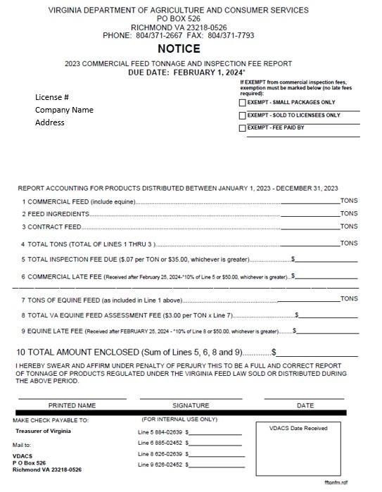
Tonnage
The form is due February 1st
For feed and treats sold loose or in packages greater than ten pounds.
  “Cookie Bar”
If you only sell prepackaged pet treats in increments of less than ten pounds; you will mark Exempt – Small Packages Only
  Print name, sign, date and return the form to our office
All businesses with an active license must return this form annually to “report your tonnage”.

Slide 5
Manufacturing
Pet Treats can be manufactured in a home kitchen.
An inspection prior to manufacturing is not required, but we are allowed by §3.2-4809 to conduct an inspection.
When manufacturing, be sure to follow the U.S. Food and Drug Administration’s Current Good Manufacturing Practices (CGMPs)
These can be found through an online search of 21 CFR Part 507 Current Good Manufacturing Practices for Animal Food.

Slide 6
Labeling
We review all small packaged feed labels prior to registration.
From our law:
§ 3.2-4804. Product registration required of commercial feed distributors. D. Every manufacturer or guarantor of small package commercial feed shall: (i) apply for registration for each small package commercial feed on forms furnished or approved by the Commissioner; (ii) pay a registration fee of $50 to the Commissioner by January 1 per small package commercial feed, in lieu of an inspection fee for this size package; and (iii) submit a copy of any label, used or proposed to be used with the small package commercial feed for approval with the registration form.

Slide 7
Properly Formatted Label Example
In the next couple of slides, we will be breaking down what is required on a standard label…
SWEET POTATO CRUNCHIES
Dog Treat
Ingredients: Sweet potato, flour, coconut oil, sugar
Guaranteed Analysis To be fed as a snack or treat Crude Protein --- min4% for small dogs.
Crude Fat -------- min 8%
Crude Fiber ----- max 4%
Moisture ---------max 12%
Calorie Content (ME) 125 kcal/kg
25 kcal/treat
ABC Treats, Dogtown, VA
ABCTreats@gmail.com
Net Weight 8 oz. (227 g)

Slide 8
Label Requirements
Brand Name
Bucky’s Biscuit Bits
Krazy Kitty Krunchies
Sweet Potato Biscuits
Intended Species
Dog, cat, horse, etc. – the species the treat is manufacturer for must be written on the front of the label, if not a part of the brand name.
Notes:
Kind of pet - A picture is not sufficient to meet this requirement.

Slide 9
Label Requirements
Quantity
Statement
Expressed as weight for solid products or volume for liquid products in avoirdupois:
U.S. and metric equivalent.
  Net weight 8 oz. (227 g)
  Net Weight 12 FL. OZ. (355 mL)

Slide 10
Label Requirements
Ingredient Statement
A continuous list of each approved ingredient using the name of the ingredient adopted by AAFCO- Chapter 6 Official Publication.
Ingredients shall be listed in descending order of predominance by weight.
If there is no designated name adopted by AAFCO, use the common name of the product such as ‘sugar’, ‘cheese’, ‘yogurt’, etc.
Avoid descriptors of quality or grade.
  Ex. Grade A eggs, Handmade cheese
Ingredients:
Peanut butter, flour, butter, cinnamon
Ingredients:
Sweet potato, flour, butter, sugar
CBD, Hemp products, and THC are not allowed in products with a guaranteed analysis.

Slide 11
Label Requirements
Guaranteed Analysis
This must include the correct heading and include (at a minimum) the following components stated in the order and format listed below:
  Crude protein (min) XX%
  Crude fat (min) XX%
  (If labeled as ‘low or reduced’ fat, also include: Crude fat (max) XX%)
  Crude fiber (max) XX%
  Moisture (max) XX%
  All additional or voluntary guarantees must be listed thereafter in the appropriate format with appropriate units.
Guaranteed Analysis
Crude Protein – min 10%
Crude Fat – min 2%
Crude Fiber – max 5%
Moisture – max 12%
Notes:
A laboratory report is not required. You can calculate the required information from the ingredients being used.

Slide 12
Label Requirements
Nutritional Adequacy Statement
If the product is clearly identified on the front label as a snack or treat, a nutrition statement or purpose statement is not required.
Manufacturer/Guarantor
As the manufacturer or guarantor of the product, your name and mailing address is required to be on the label.
Name and address of guarantor/manufacture of the feed.
Should be the same as on your feed license.
E-mail address may be present, but not a substitute for location address.
Notes:
Nutritional Adequacy - However, we recommend that a statement such as “Feed as a snack or treat.” or “For intermittent or supplemental feeding only.” be included to ensure consumer awareness.
Manufacturer/Guarantor - For safety reasons, we recommend that you obtain a post office box if your business is not listed in a local telephone directory. If listed, only the business name, city, state and zip code are required for contact information. A telephone number may be included but is not required.

Slide 13
Label Requirements
Calorie Content
The label of a dog or cat food, including snacks, treats, and supplements, shall bear a statement of calorie content and meet all of the following:
  The statement shall be separate and distinct from the "Guaranteed Analysis" and appear under the heading "Calorie Content"
  The statement shall be measured in terms of metabolizable energy (ME) on an “as fed’ basis and must be expressed, in either the words "metabolizable energy" or the abbreviation "ME“:
    both as “kilocalories per kilogram” (“kcal/kg”) of product, and as “kilocalories per familiar household measure (e.g., cans or cups) or unit of product (e.g., treats or pieces)”
Notes:
You can calculate this if you have Protein, Fat, Fiber, Moisture and Ash content of the product.

Slide 14
Claims
Must be truthful and substantiated
Whitens teeth, freshens breath, etc.
Dental claim needs to include the “mechanism” for the plaque and tartar removal. i.e Chewing helps to scrape away plaque and tartar.
Low calorie dog treats
Must indicate in feeding directions how to feed to meet claim.
Cure Cancer
Unless it can be substantiated, will not be allowed.
High in Vitamin E
Must be guaranteed in the Guaranteed Analysis (GA) if claimed.
What is substantiation?
Variable pending the claim made:
Guarantees in GA
Specification sheets for ingredients from manufacturer of ingredient.
Multiple peer reviewed journal articles for the intended species at the inclusion rate in the ingredient statement.

Slide 15
Questions
Are dehydrated or freeze-dried chicken feet allowed without a commercial kitchen?
  If this is an animal food, yes.
Does pet food have to be at a certain temperature, what are the guidelines?
  It depends on the product. If it’s a temperature-controlled product i.e. frozen pup cup, it must be kept in at a temperature to prevent adulteration.
How do you go about starting an onsite dog food company?
  Please contact the Agricultural Commodities Program (ACP). We will provide you with the information and documents needed to become licensed and registered.

Slide 16
Questions
Where do you find insurance for starting a dog food company at a farmers’ market?
  I do not know – possibly reach out to your insurance agent for help.
Can you sell pet food/snacks at more than farmers markets and wholesale without a commercial kitchen?
  Yes, you can sell animal food without a commercial kitchen but are still required to license and if applicable, register products.
  Ground poultry as Pet Food i.e. Beef, Pork, Chicken, Turkey
  Yes, you can sell ground meat as a supplemental pet food, but it must be kept under conditions to prevent adulteration i.e. spoilage, contamination.
Notes:
We are also allowed by §3.2-4809 to conduct an inspection of the manufacturing location, even a home kitchen.

Slide 17
Helpful Resources
*Note that registration in Virginia does not mean registration in other states. Each state has theirSorry own license and registration requirements.
VDACS pet treat guidance booklet
AAFCO - Labeling & Labeling Requirements | AAFCO
FDA- FDA's Regulation of Pet Food | FDA

